Slide 1


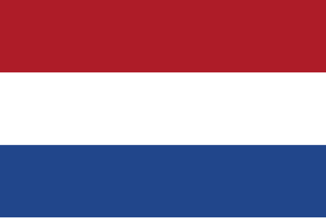


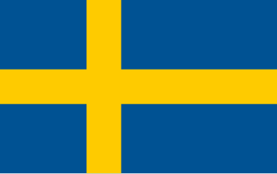
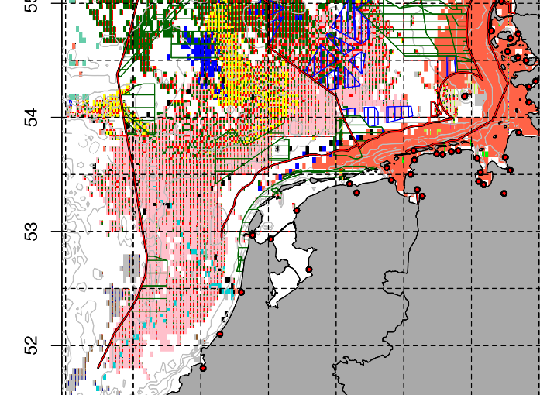
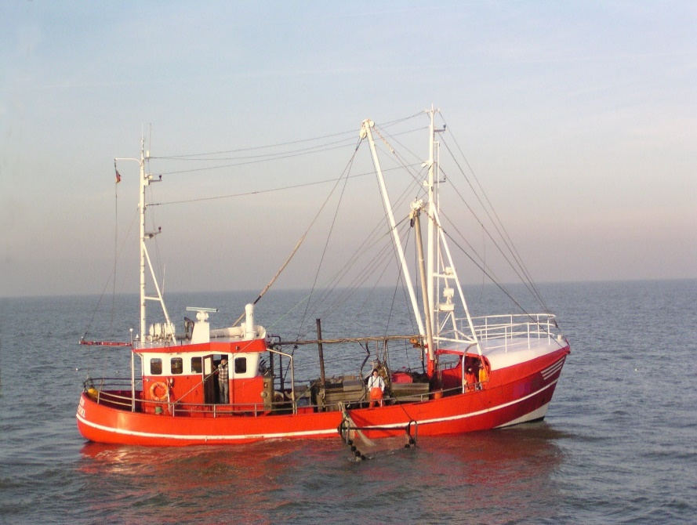
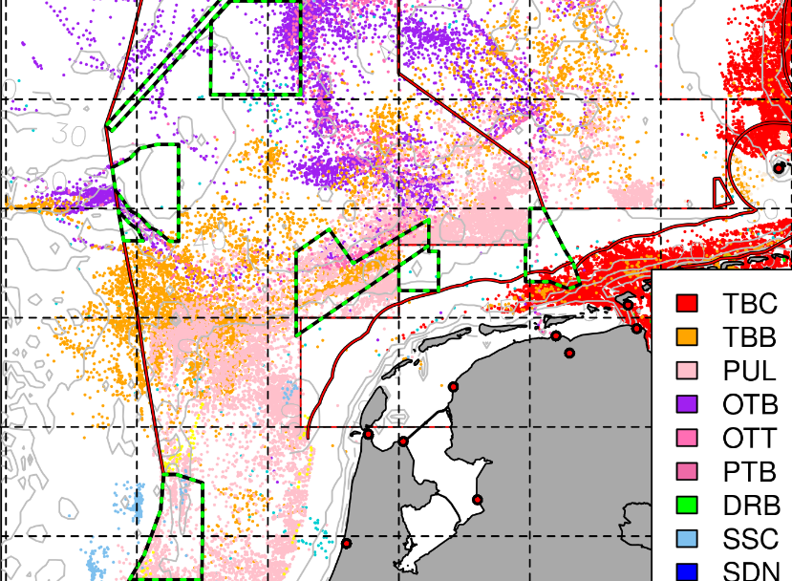
GNSBI: Greater North Sea Basin Initiative
Multi Stressor Analyses of European Fisheries in the North Sea
Main authors: Dr. Torsten Schulze, Dr. Casper Kraan
Thünen Institute of Sea Fisheries, Germany
GNSBI stakeholder workshop
dd. MM 2026

Slide 2


Agenda
Methods
Study area, data used, scenarios
Plausibility check by maps
Indicator of Challenge <- (Individual) Stress Level, (I)SL
Results
Fleet of five. Impact on
- specific fisheries (gear type)
- individual businesses (vessels)
- coastal areas (port communities)
National fleets. Impact on
- specific fisheries (gear type)
Summary

Slide 3
GNSBI LTFP
METHODS

Slide 4
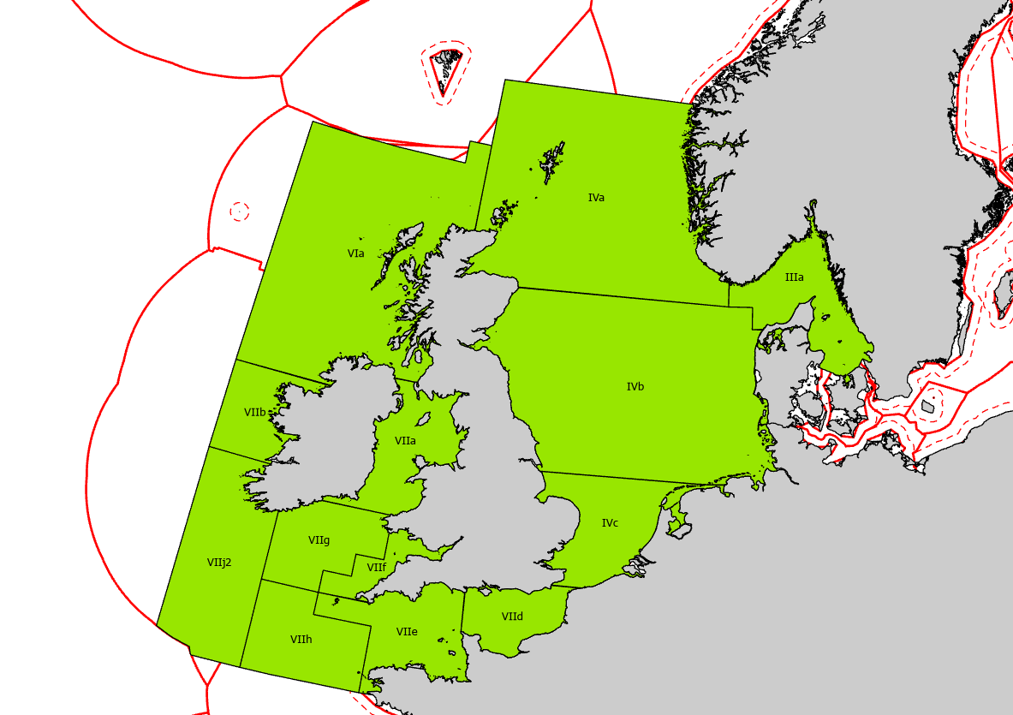
GNSBI area
Analyses of north European fisheries
Analyses and aggregation of data (“fleet of five”)
BEL NLD DEU DNK SWE
Spatial management of: BE, NL, DE, DK, SE + NO, UK
Also outside GNSBI area
All vessels with effort in the GNSBI area (green)
are kept with all effort (outside also) to be analysed
!

Slide 5
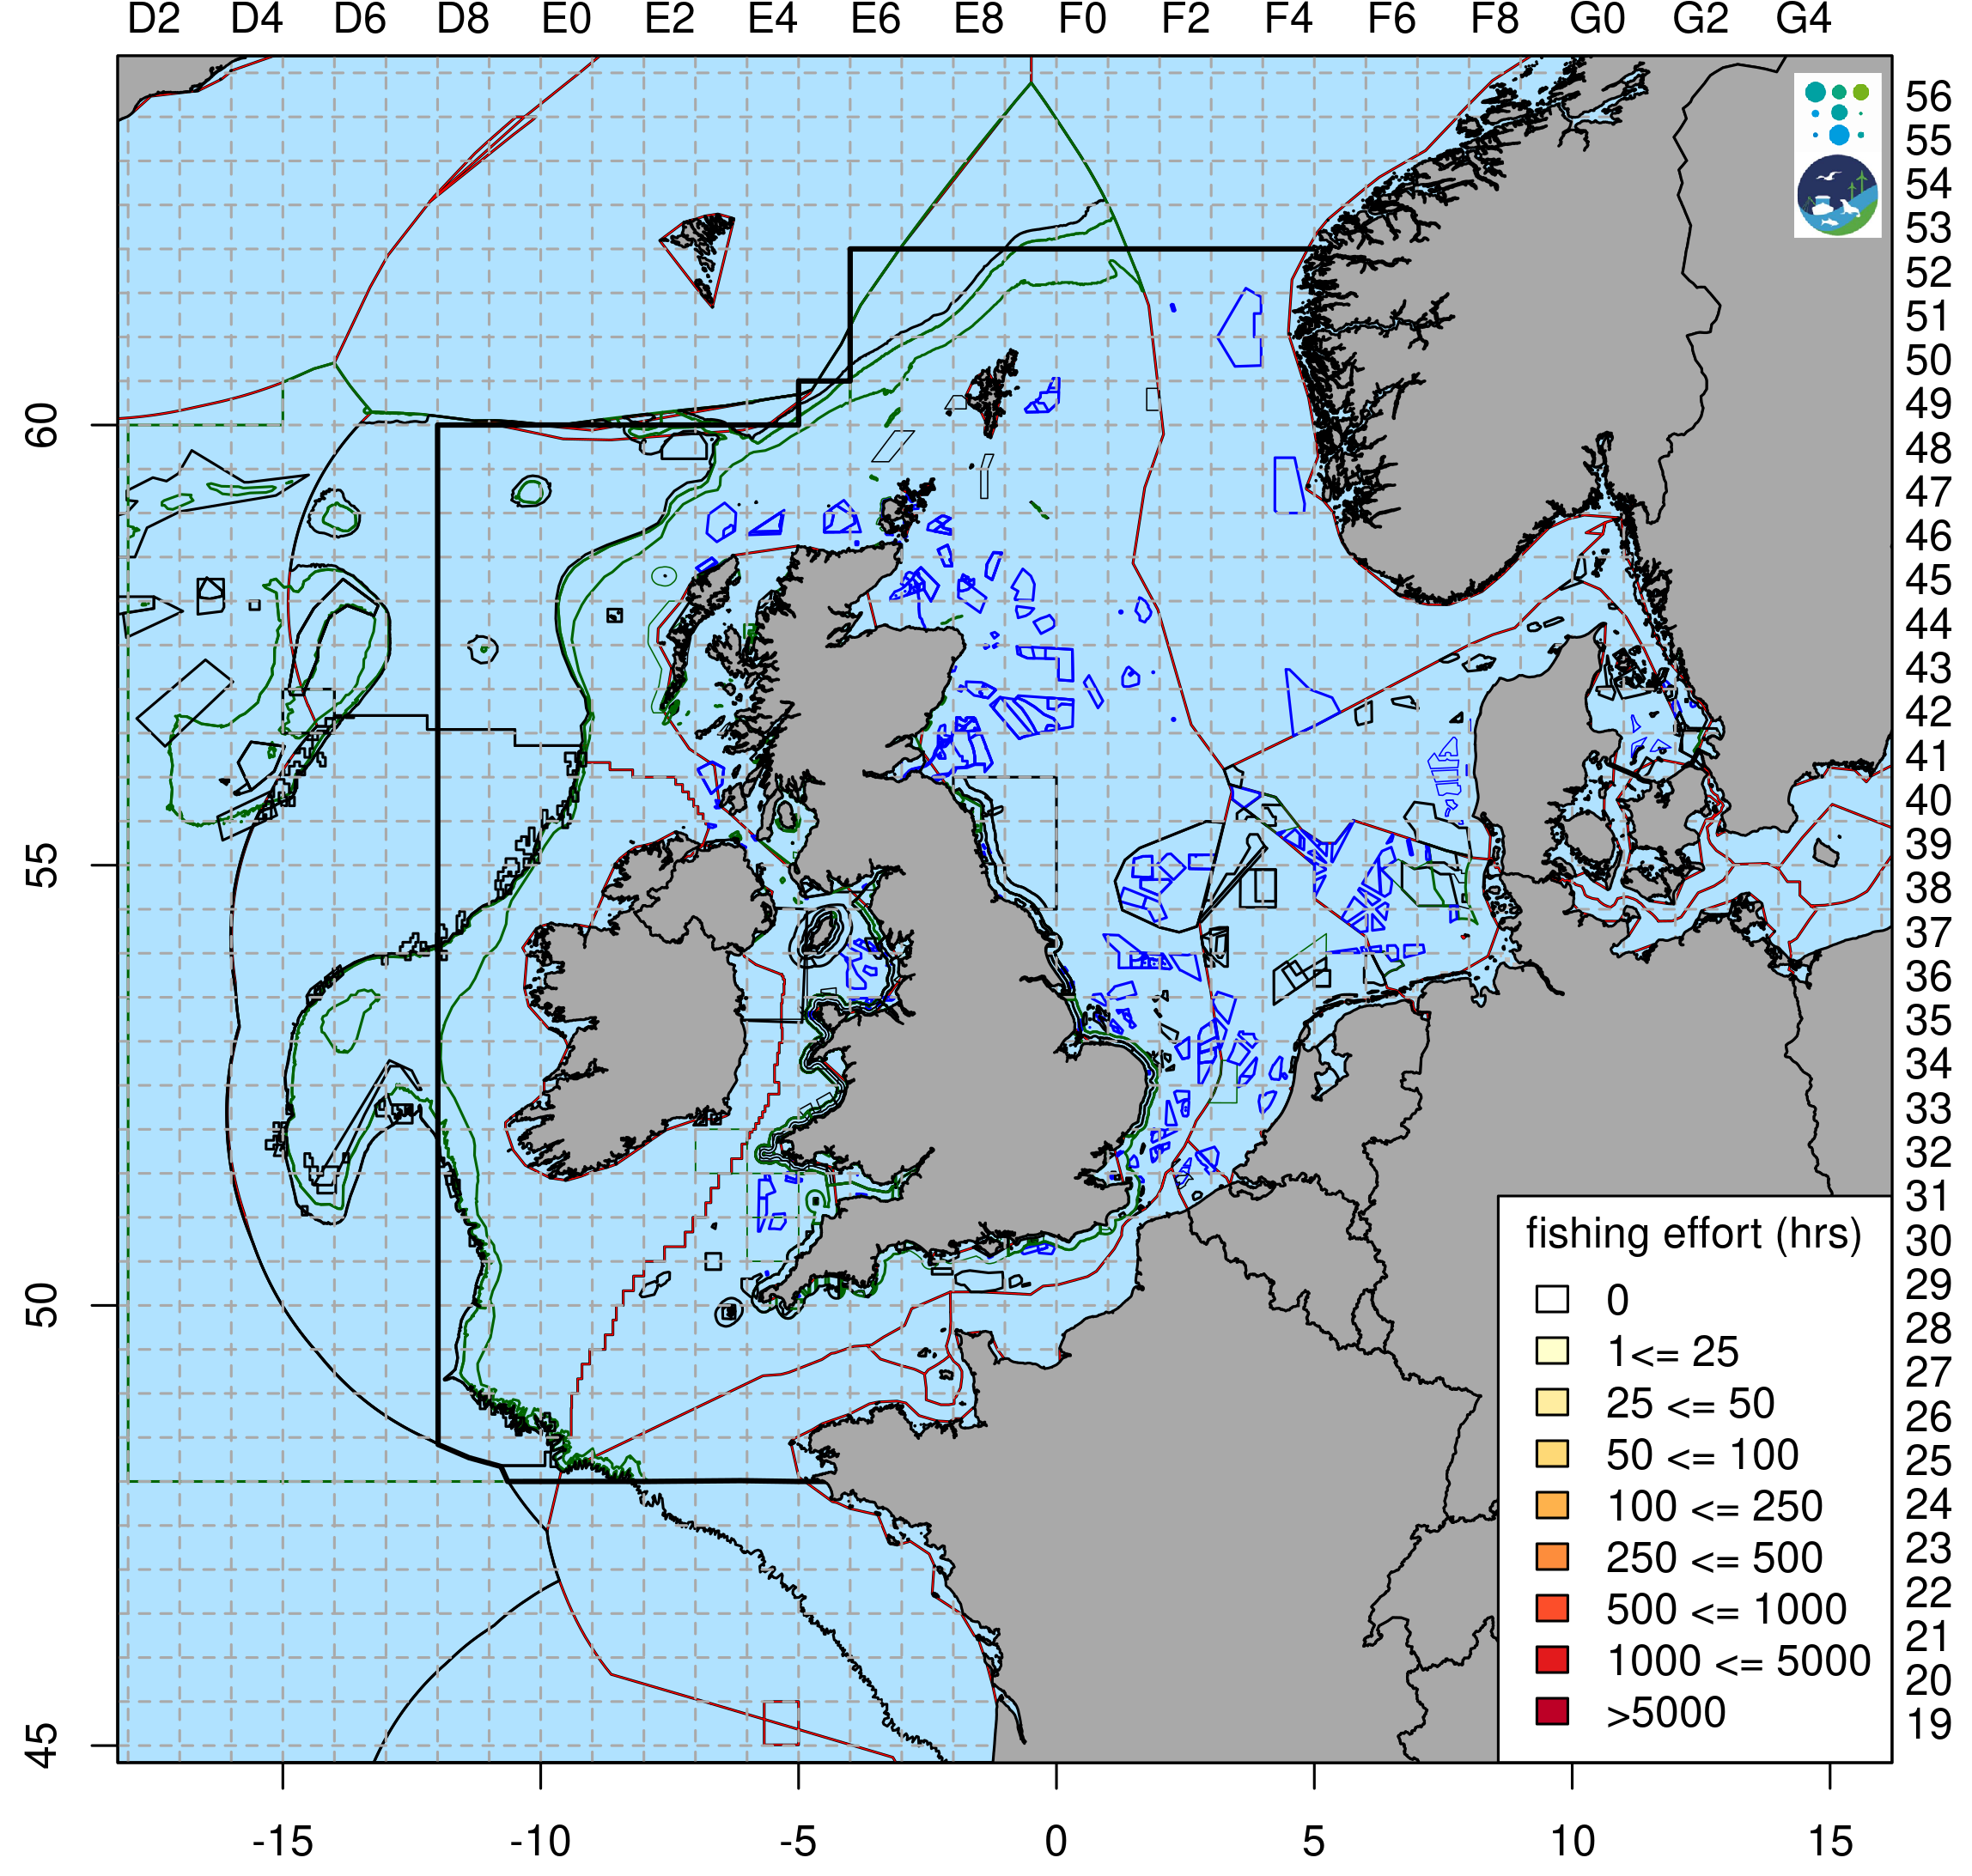

Aim: Mapping and Multiple Stressors Analyses
red + black
EEZ borders
Specific management in ~ 850 single areas (shapes)
Offshore Renewables (mostly Wind farms, blue)
to be built until latest 2030 and nationally decided until end 2023 (cut-off date)
blue, thick: no fishing, thin: passive gears allowed
Nature protection
specific Natura 2000 fisheries management decided until end of 2023
not the designated areas in total
Black, thin: management of mobile bottom contacting (mbc) gears
Green: management of passive gears (mostly to protect birds and mammals from bycatch)
: EEZ Borders
: GSNBI area
fisheries management
blue: wind farms
black: mbc gears
green: passive gears

Slide 6
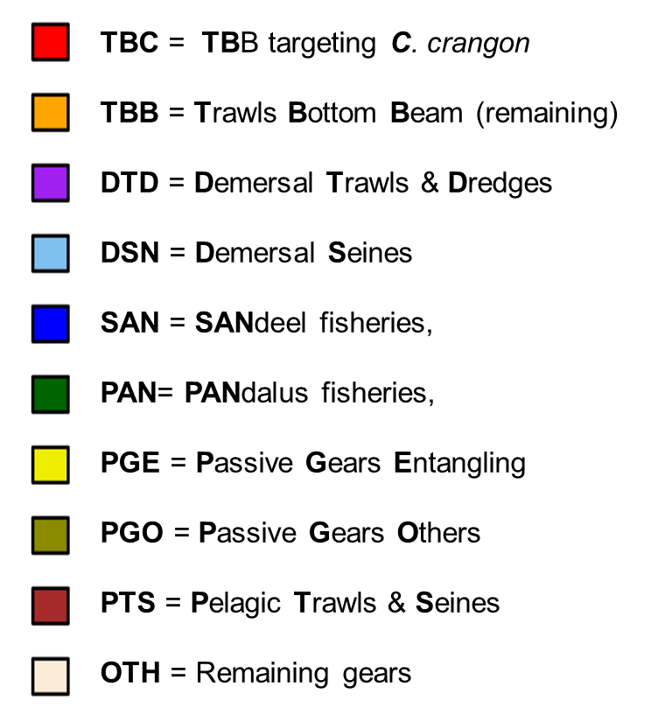
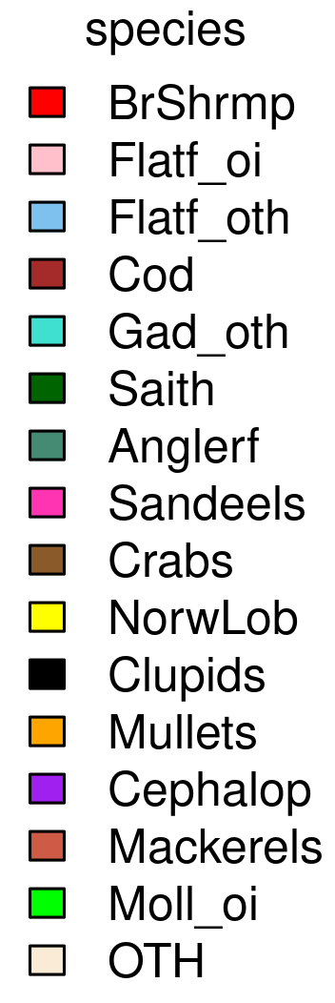
Scenarios and years in analyses
Specific Fisheries
Spatial scenarios
Offshore Renewables (e.g. wind farms): ‘Wind’
Nature Protection (e.g. Natura 2000): ‘NatPrt’
Cumulative: ‘NatWnd’
10 Gear groups 16 Species groups
Years: 2018 - 2022

Slide 7
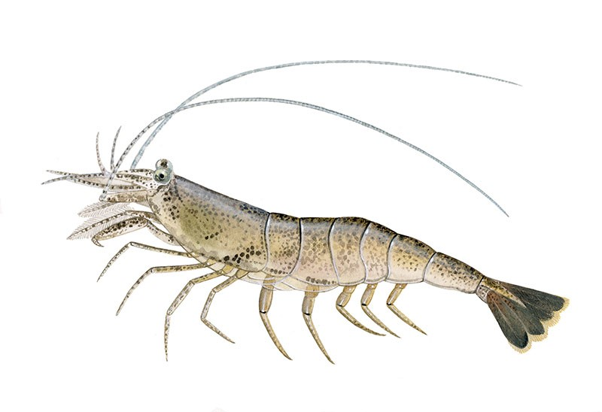
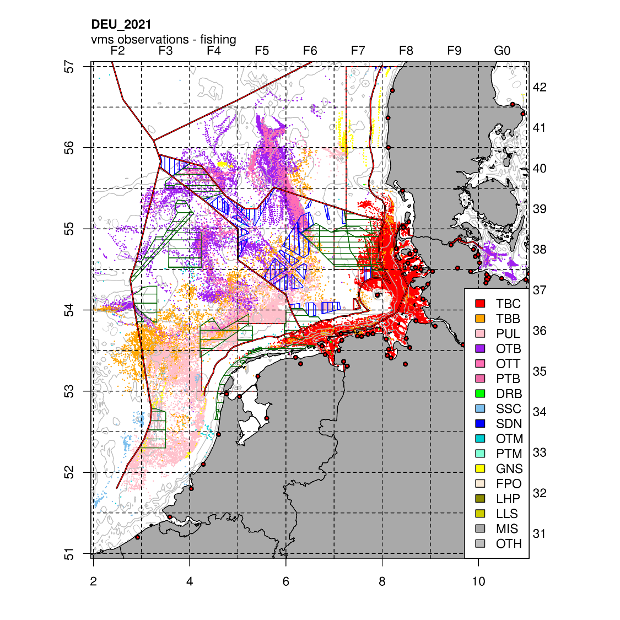
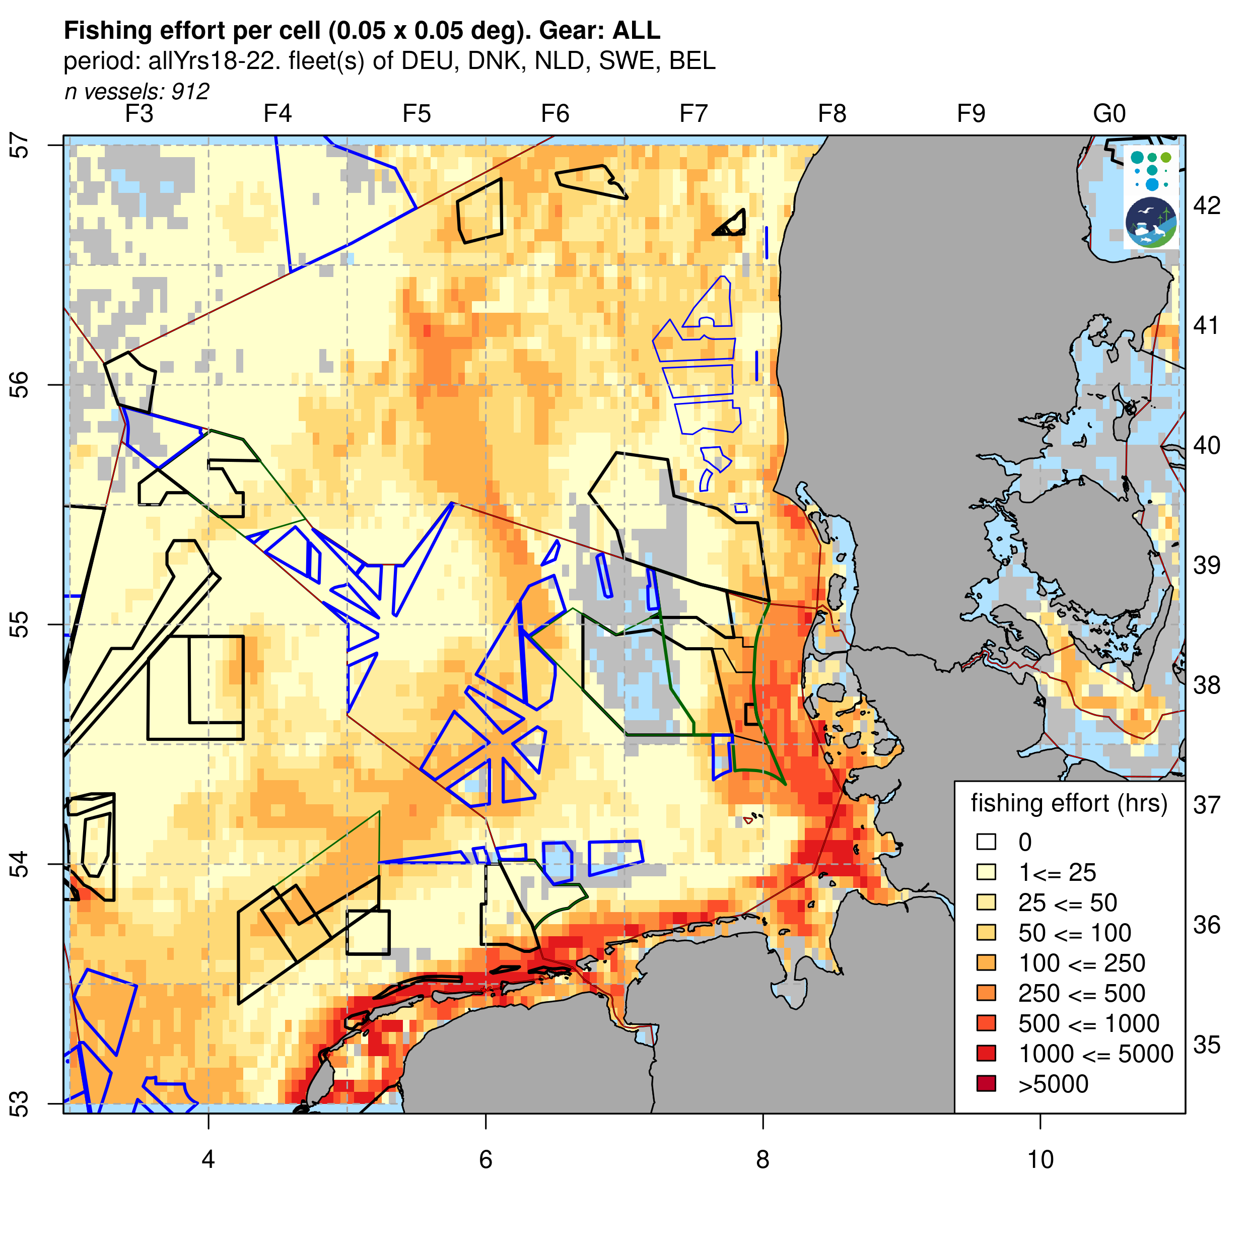
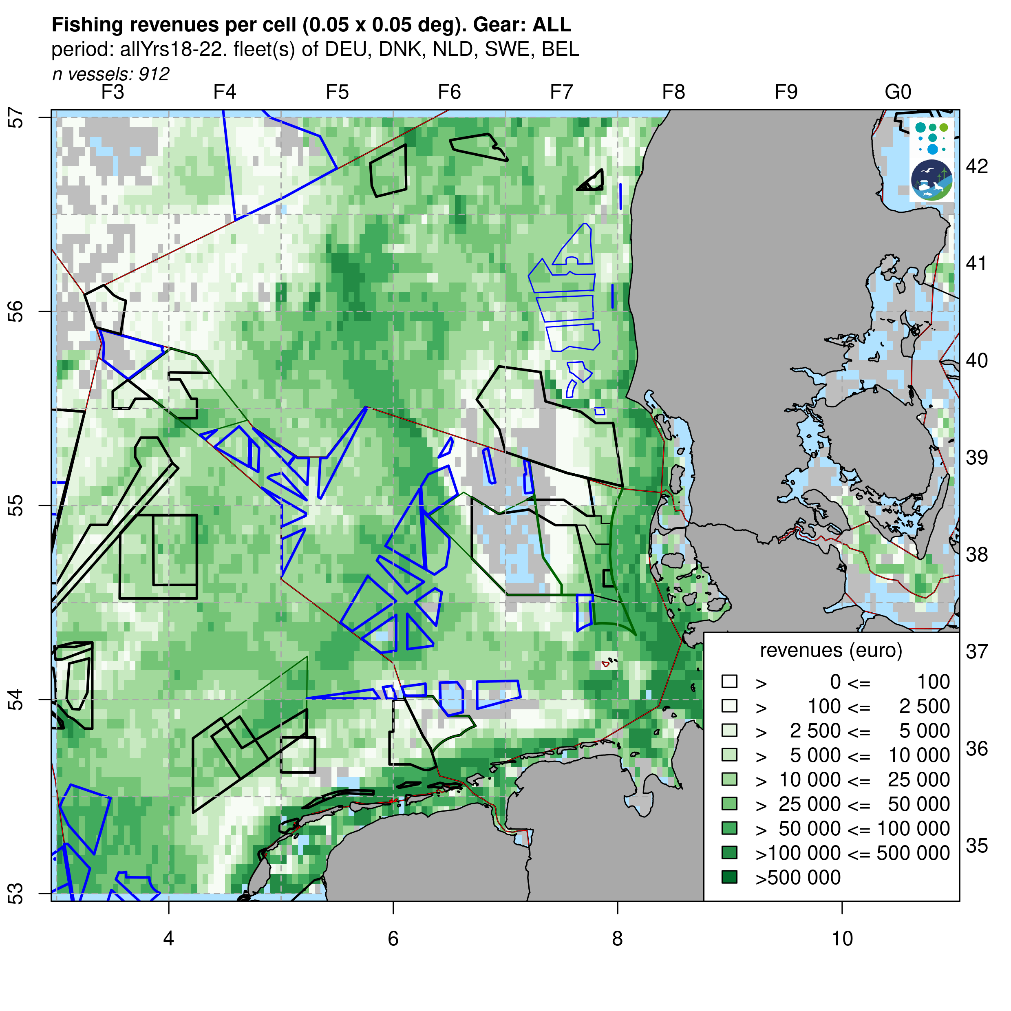
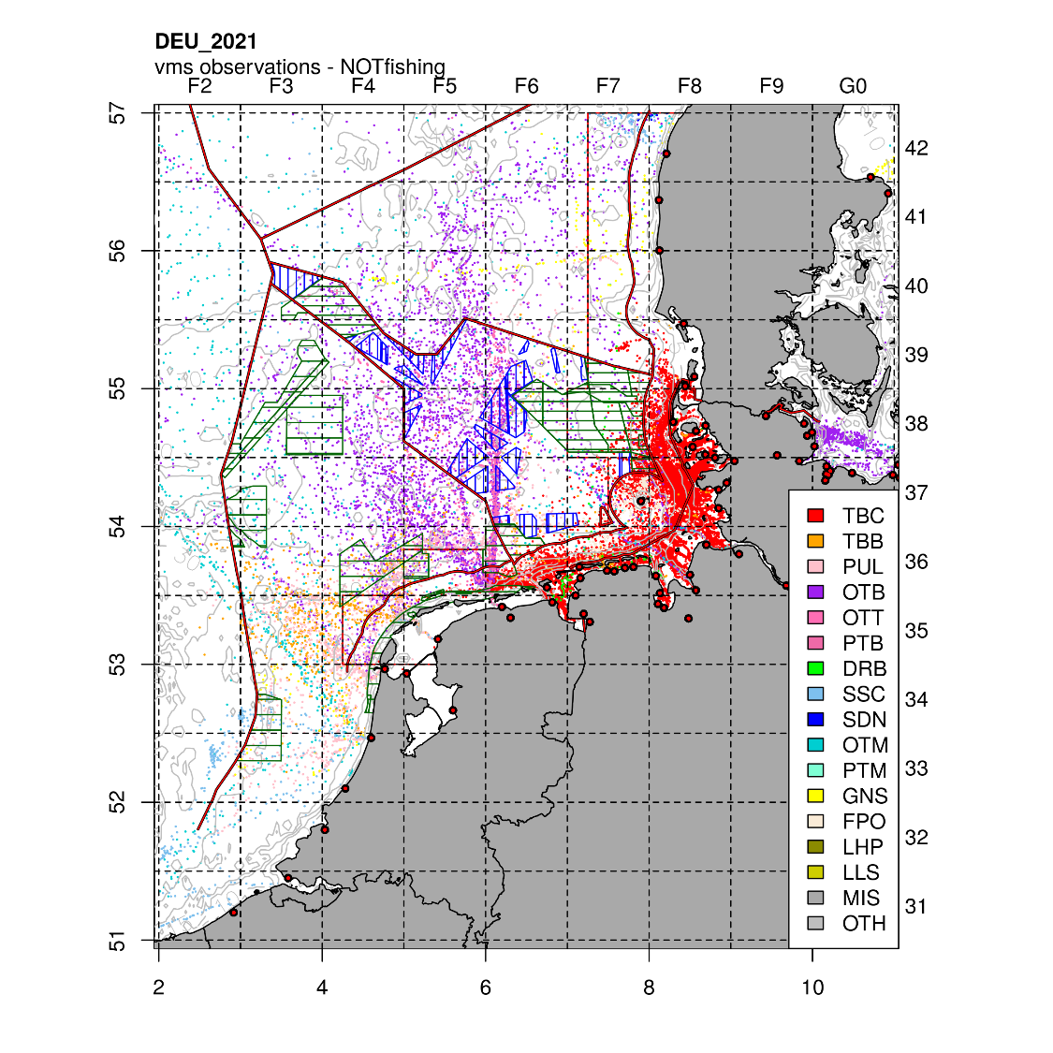
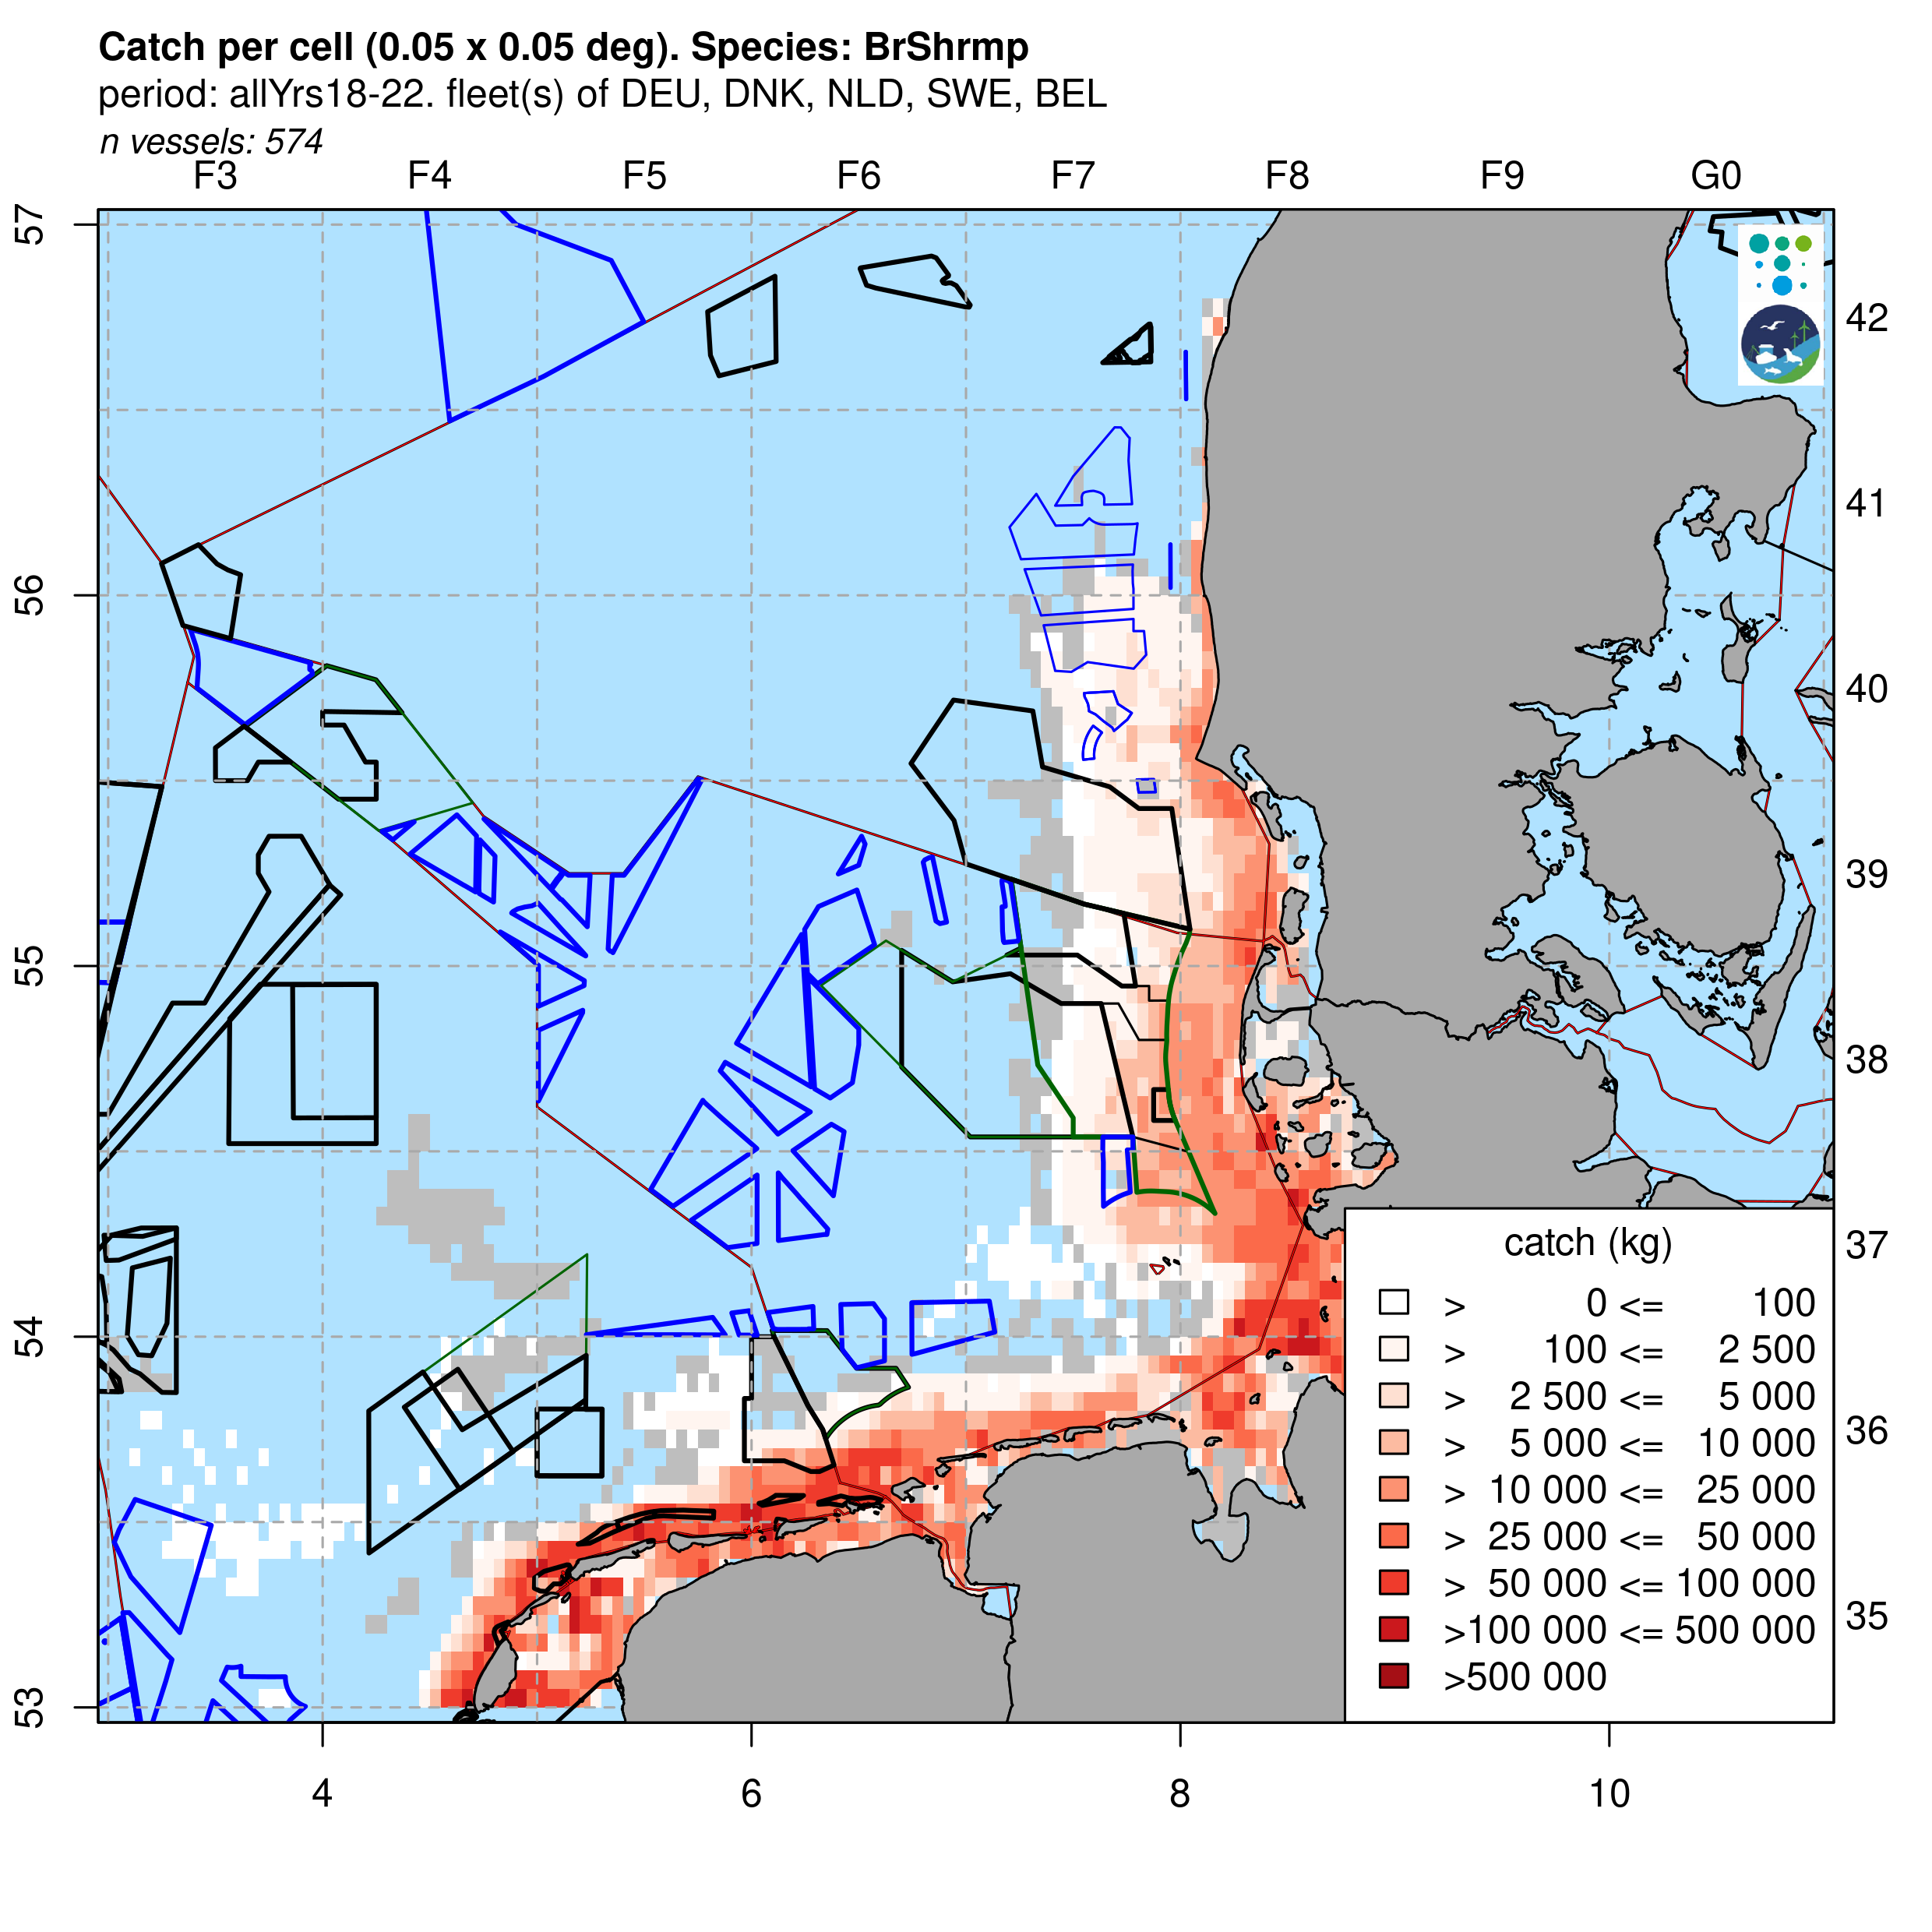
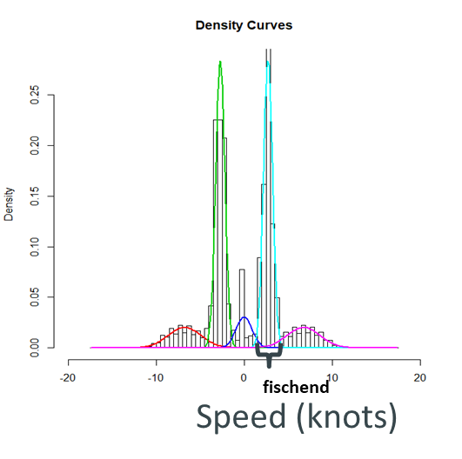
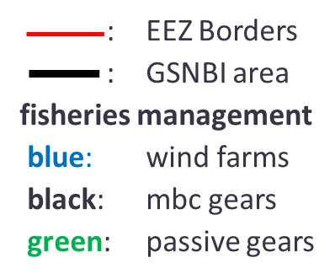
Example outputs: analyses and output options
Fisheries data used
VMS (Vessel monitoring System)
Log books
Landings
Wind farms: blue
Natura 2000: green
Use of
speed filters
Confidentiallity threshold: cells with <=5 vessels masked in maps and tables
c-squares 0.05°: see Tony Rees. The c-squares nested global grid
https://de.slideshare.net/slideshow/tony-rees-the-csquares-nested-global-grid/10112176

Slide 8
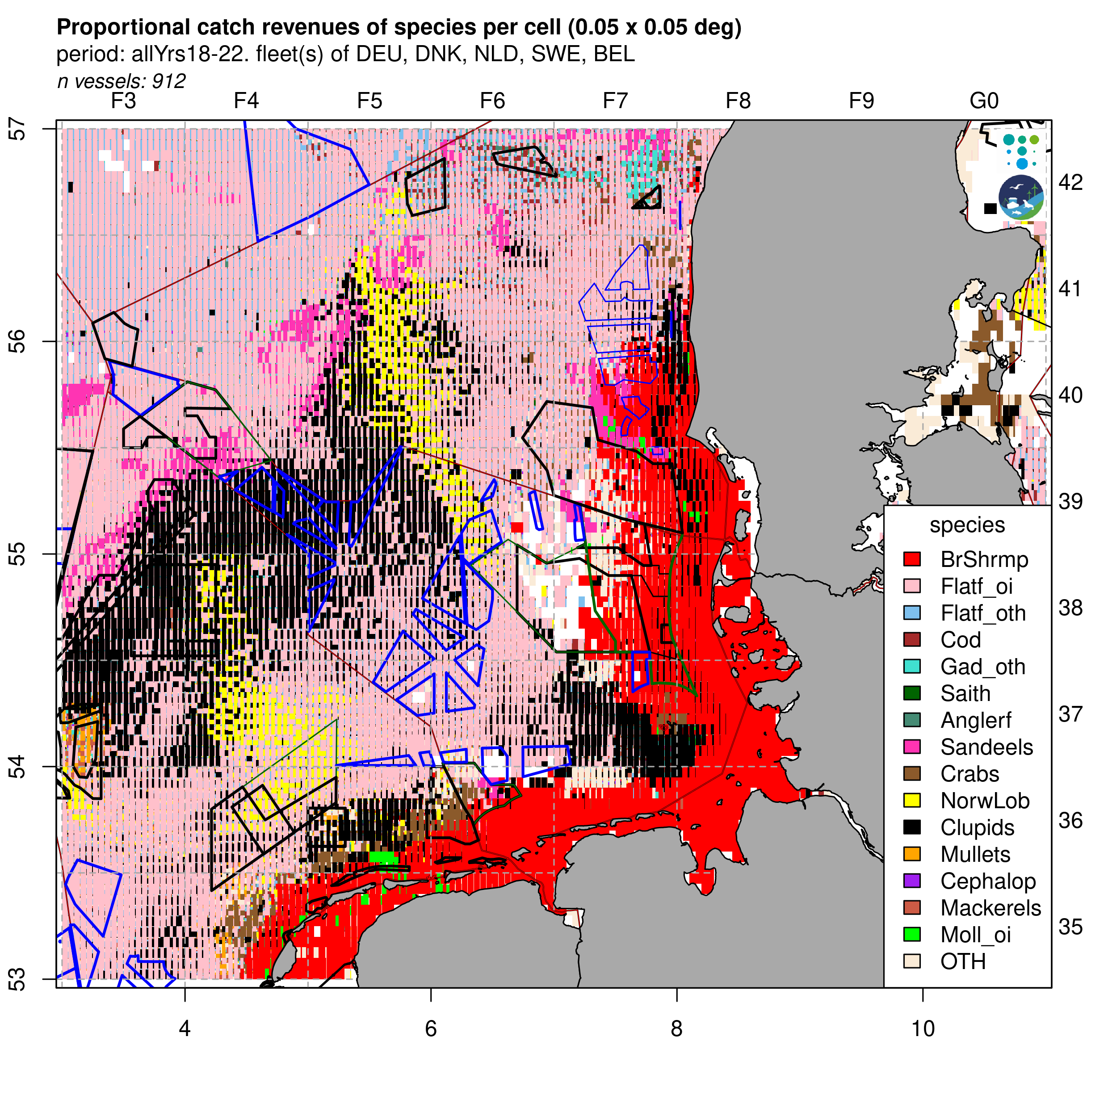
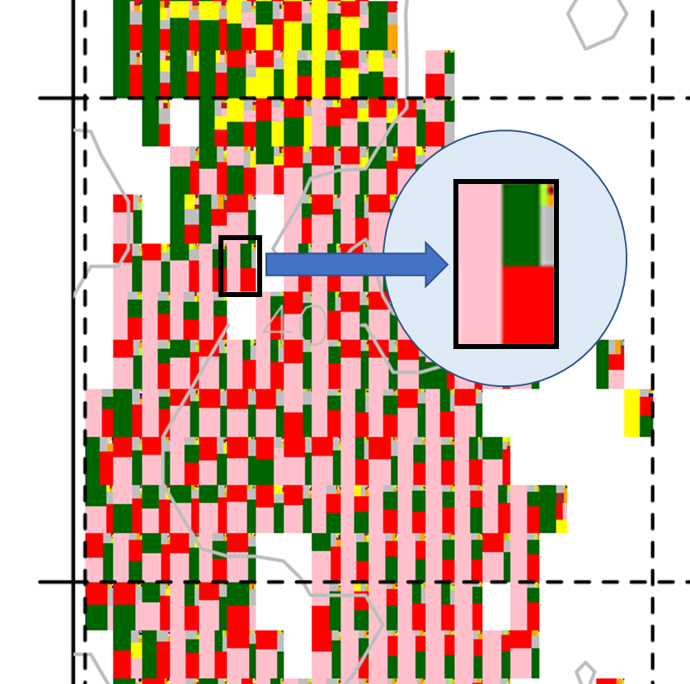
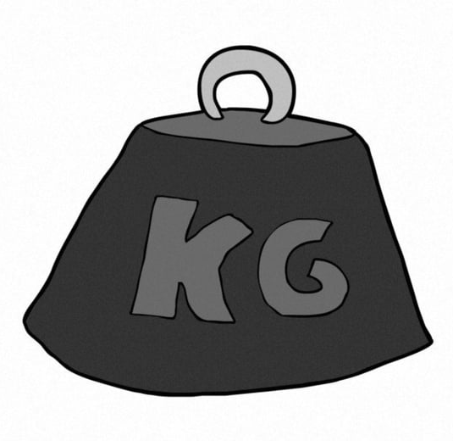
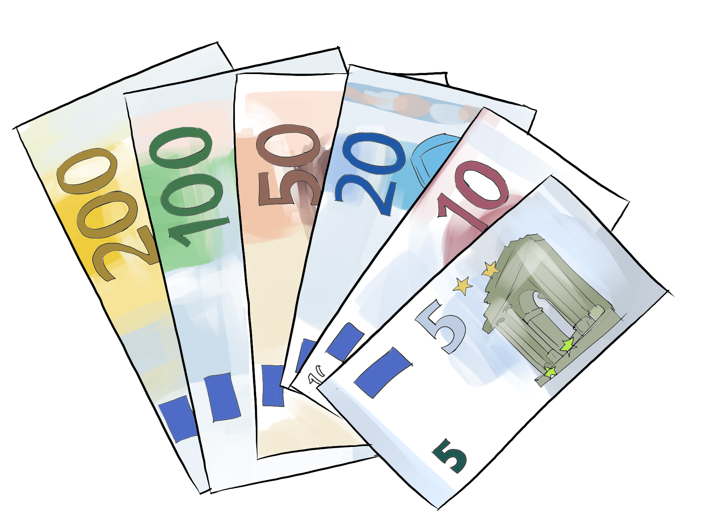
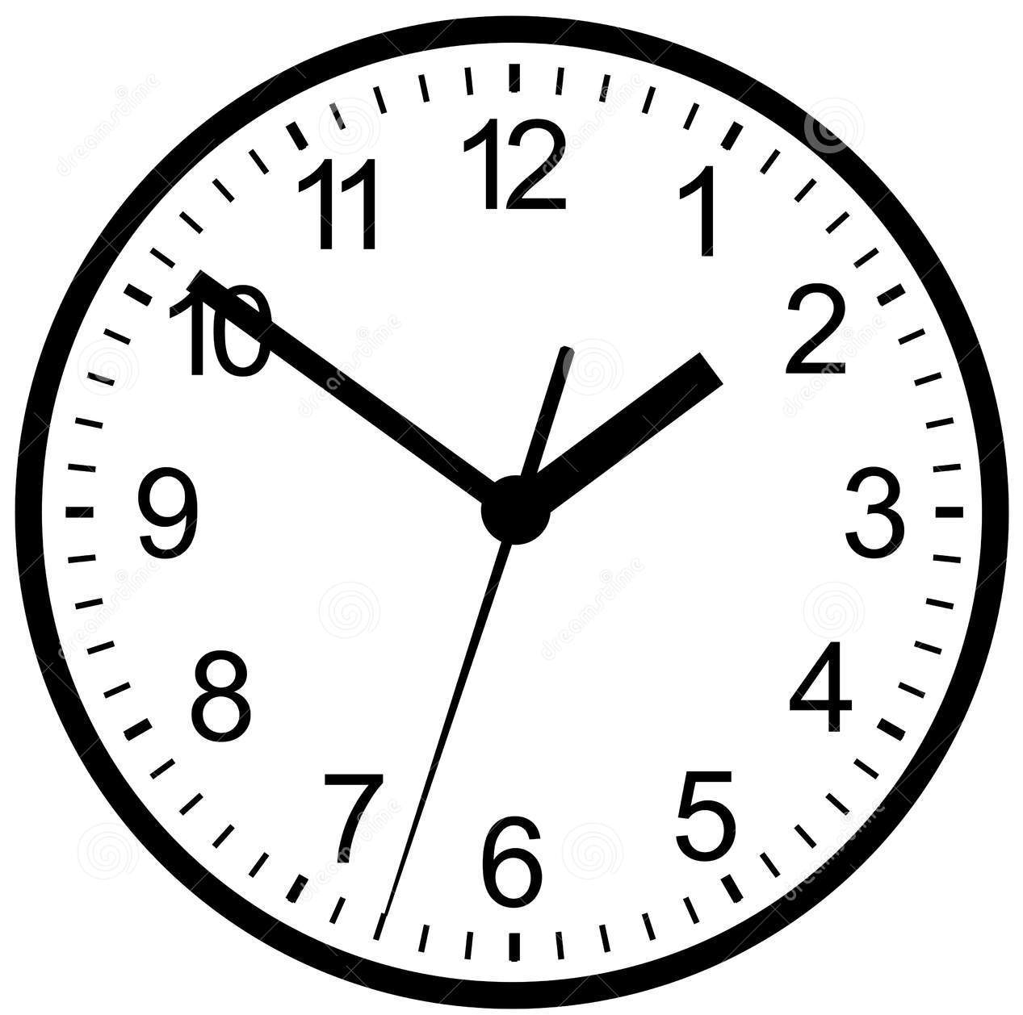
Tree Plot Maps
Tree plot maps Example: Proportional catch weight of species per cell (0.05° x 0.05°)
DEU 2021
Three types:
1. Species catch by weight (Kg)
2. Catch by revenues (€)
3. Effort by gear (hours)
see
Gerritsen, H.D. and Lordan, C. 2014. Atlas of Commercial Fisheries Around Ireland, Marine Institute, Ireland. 59 pp.

Slide 9
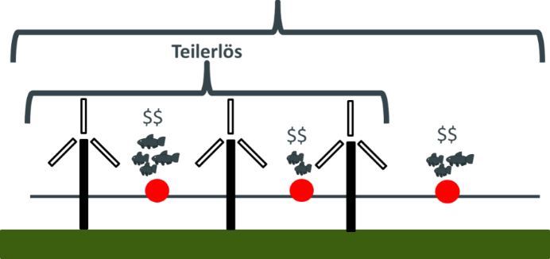
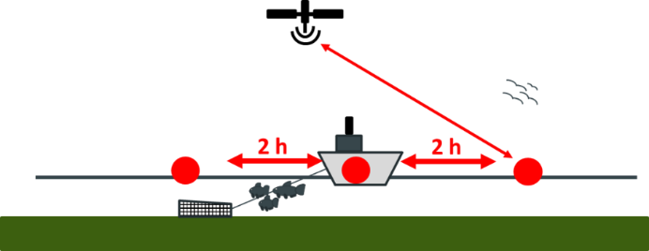
Economic Relevance – (Individual) Stress Level Analyses
Evaluation of economic relevance: Stress Level (SL)
total revenues
partial revenues
Fisheries in total
10 Million €
SL_{rev} = percent of yearly revenue in the past which was gained in an area being closed in future
Fisheries in future windfarm areas
1 Million €
SL_{revenues} = 10%
All effort (outside GSNBI area also) are kept to be analysed.
!

Slide 10
GNSBI LTFP
RESULTS

Slide 11
Revenues and Stress Level (SL) tables per activity
Period: all Years, 2018 – 2022 N vessels total: 1190
- one vessel can perform several activities
specific fisheries
TBB targetting
C.crangon
Trawls Bottom
Beam remaining
Demersal Trawls
and Dredges
Demersal
SeiNes
SANdeel
fishery
PANdalus
fishery
Passive Gears
Entangling
Passive Gears
Others
Pelagic Trawls
and Seines
all OTHer
gears
unit | Scenario | TBC | TBB | DTD | DSN | SAN | PAN | PGE | PGO | PTS | OTH
N | vessels in analyses | 452 | 290 | 532 | 72 | 114 | 70 | 77 | 30 | 151 | 92
Revenue (euro) | NatPrt | 2 257 249 | 6 201 481 | 4 701 006 | 1 363 710 | 3 929 158 | 171 804 | 1 523 753 | 18 749 | 807 370 | 1 748
 | Wind | 217 400 | 22 076 634 | 4 106 424 | 547 805 | 2 400 387 | 0 | 288 805 | 65 823 | 8 260 291 | 95
 | NatWnd | 2 474 648 | 27 774 261 | 8 751 868 | 1 902 096 | 5 712 227 | 171 804 | 1 812 558 | 84 572 | 9 038 270 | 1 843
SL.rev (%) | NatPrt | 2.14 | 3 | 1.97 | 2.65 | 10.86 | 0.73 | 7.33 | 1.35 | 0.21 | 0.02
 | Wind | 0.21 | 10.67 | 1.72 | 1.06 | 6.63 | 0 | 1.39 | 4.75 | 2.19 | 0
 | NatWnd | 2.35 | 13.42 | 3.66 | 3.7 | 15.79 | 0.73 | 8.72 | 6.1 | 2.4 | 0.02
between specific fisheries (gear groups) variation
Some gear classes considerably affected by 2030 (SL>10%: TBB, SAN)

Slide 12
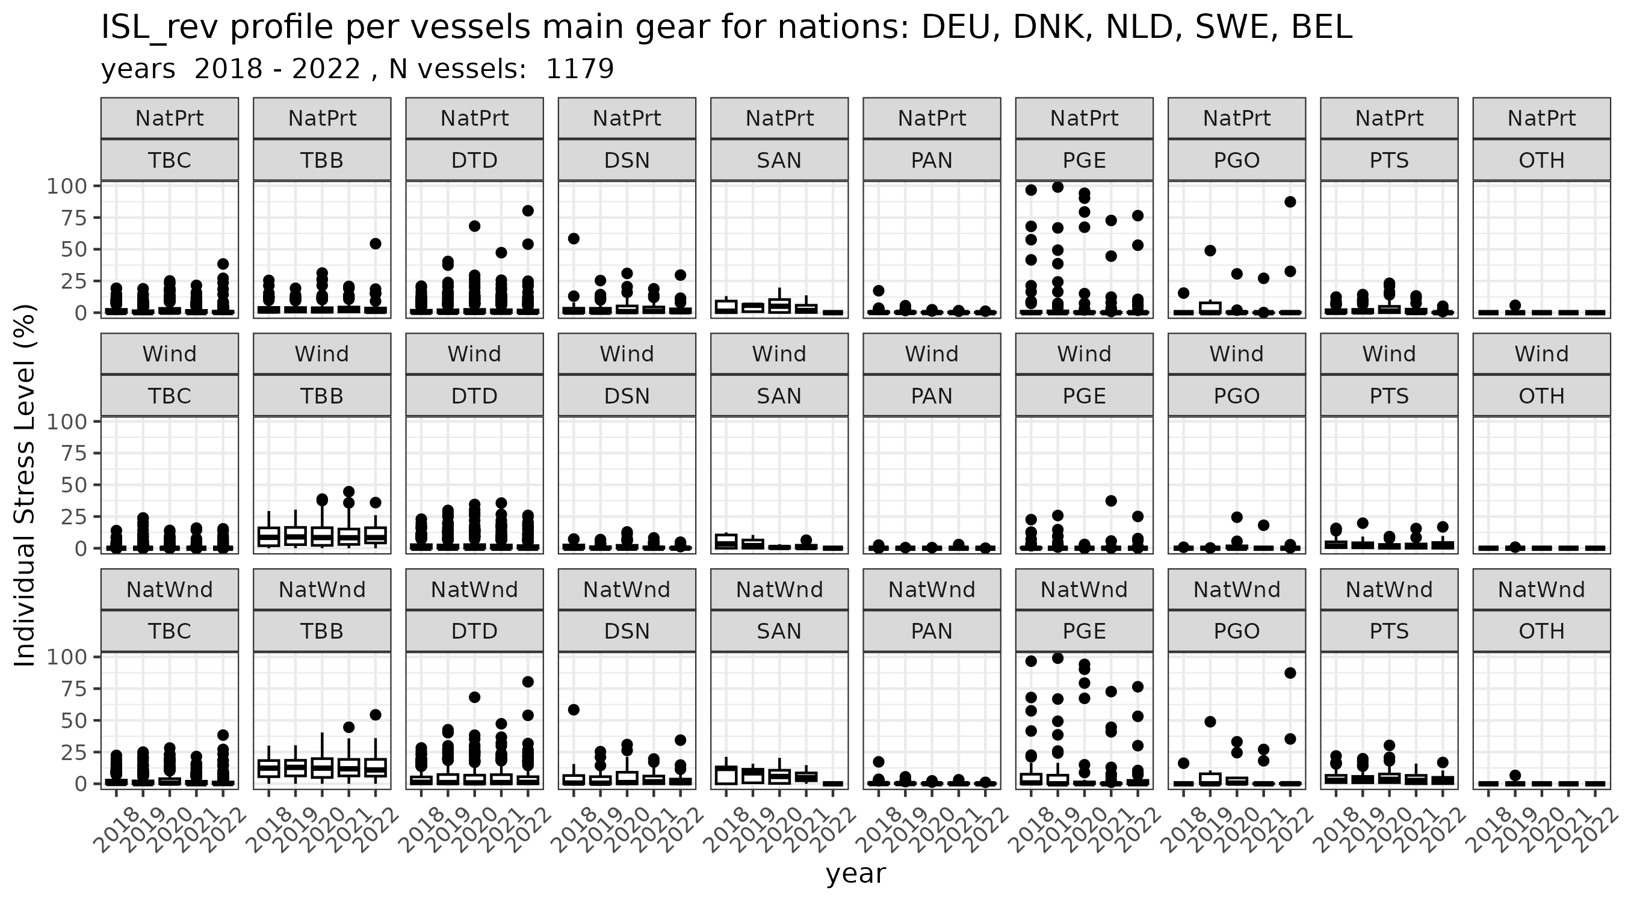
Individual Stress Level (ISL)
specific fisheries
Also for those fleets with little impact in general:
individual vessels strongly affected
e.g.: DTD, PGE, PGO
TBB targetting
C.crangon
Trawls Bottom
Beam remaining
Demersal Trawls
and Dredges
Demersal
SeiNes
SANdeel
fishery
PANdalus
fishery
Passive Gears
Entangling
Passive Gears
Others
Pelagic Trawls
and Seines
all OTHer
gears
Main gear ISL:
Gear which gains the
highest revenue of a vessel

Slide 13
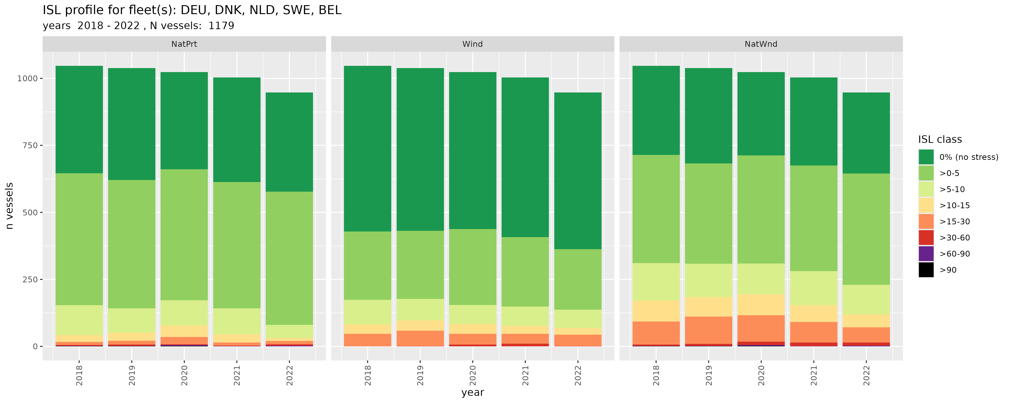
Individual Stress Level profiles international fleet
NatPrt
Wind
NatWnd
~1/4 of vessels ISL > 5%
Few extreme values of over 30%

Slide 14
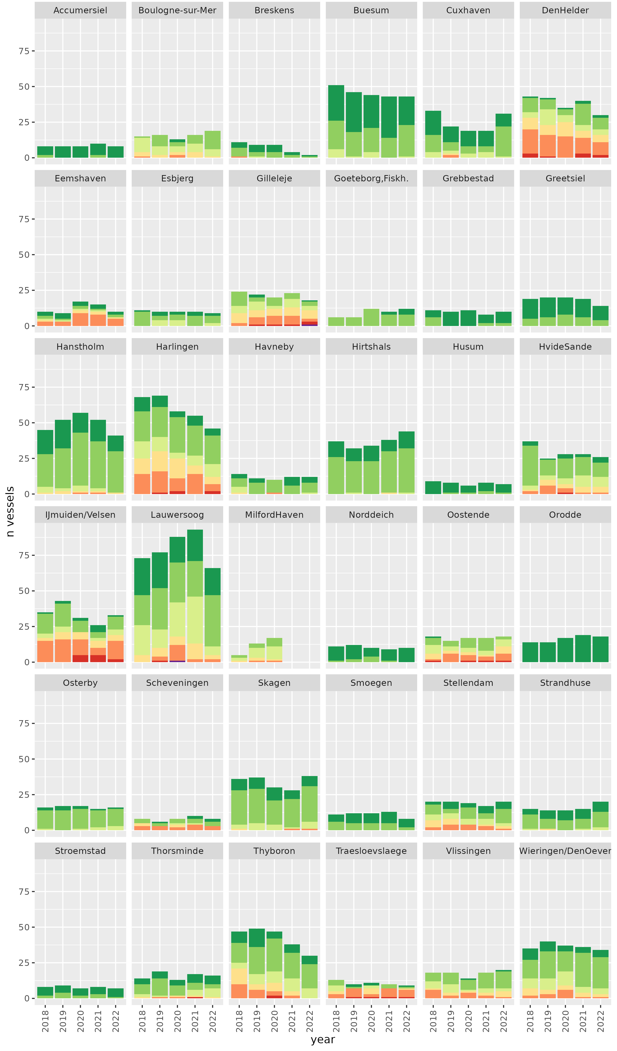

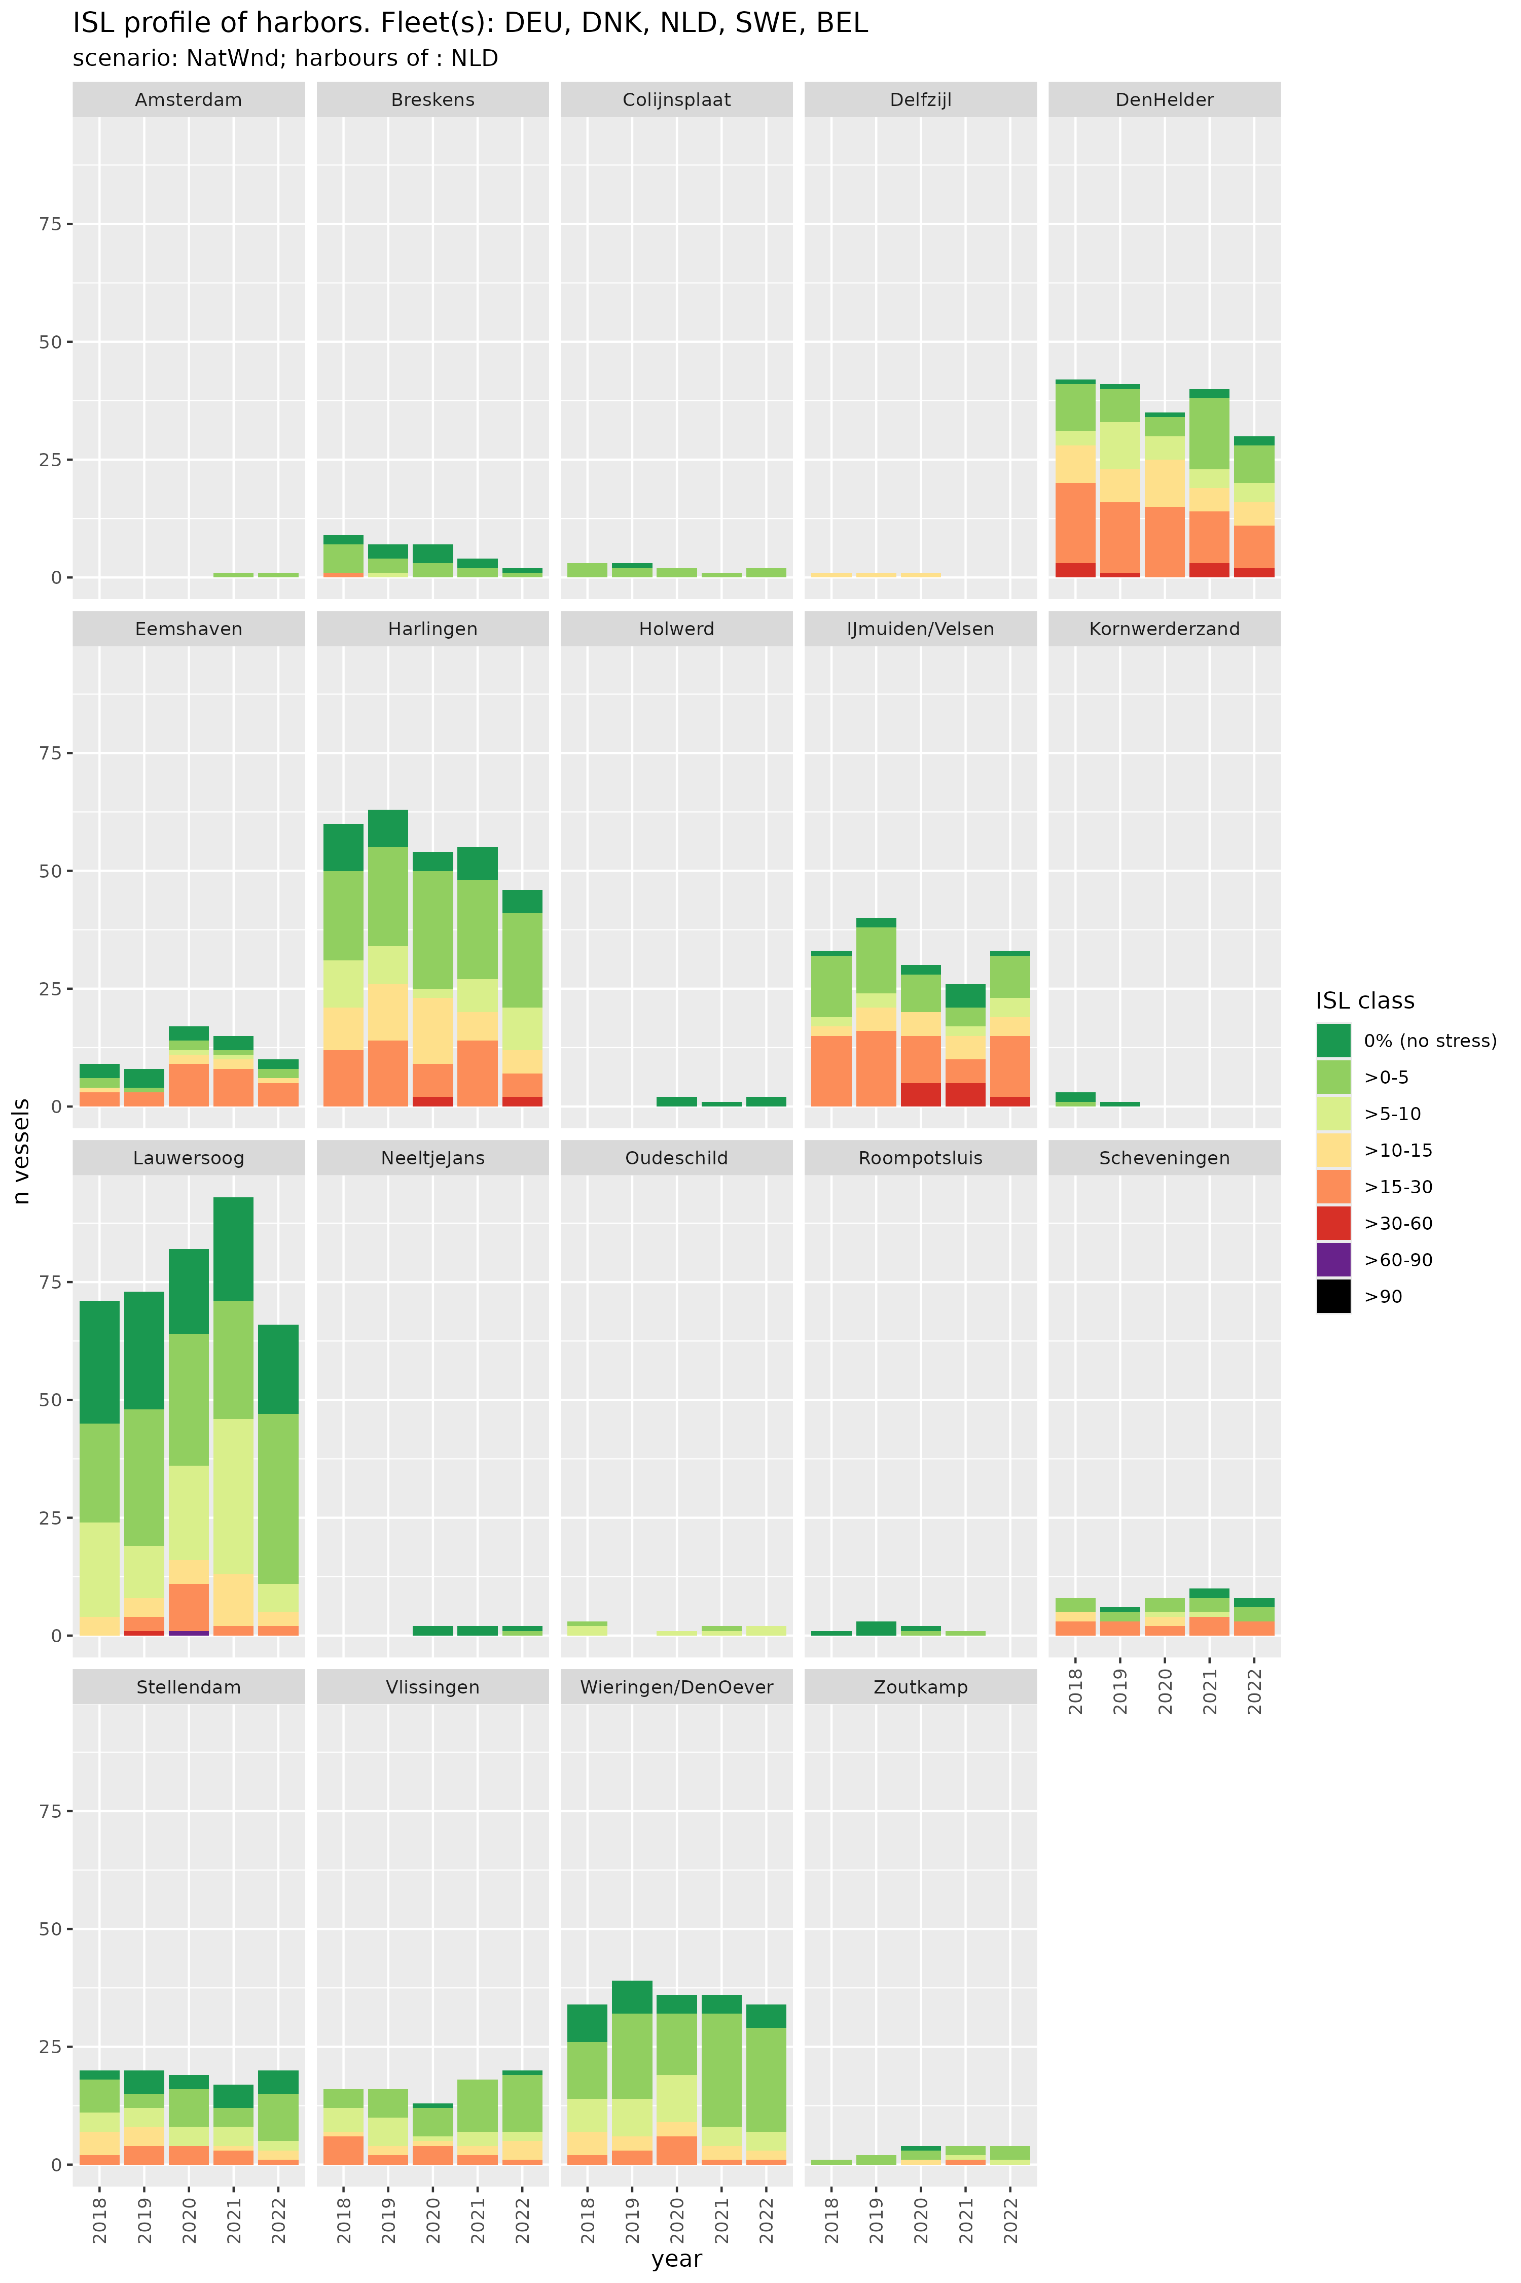

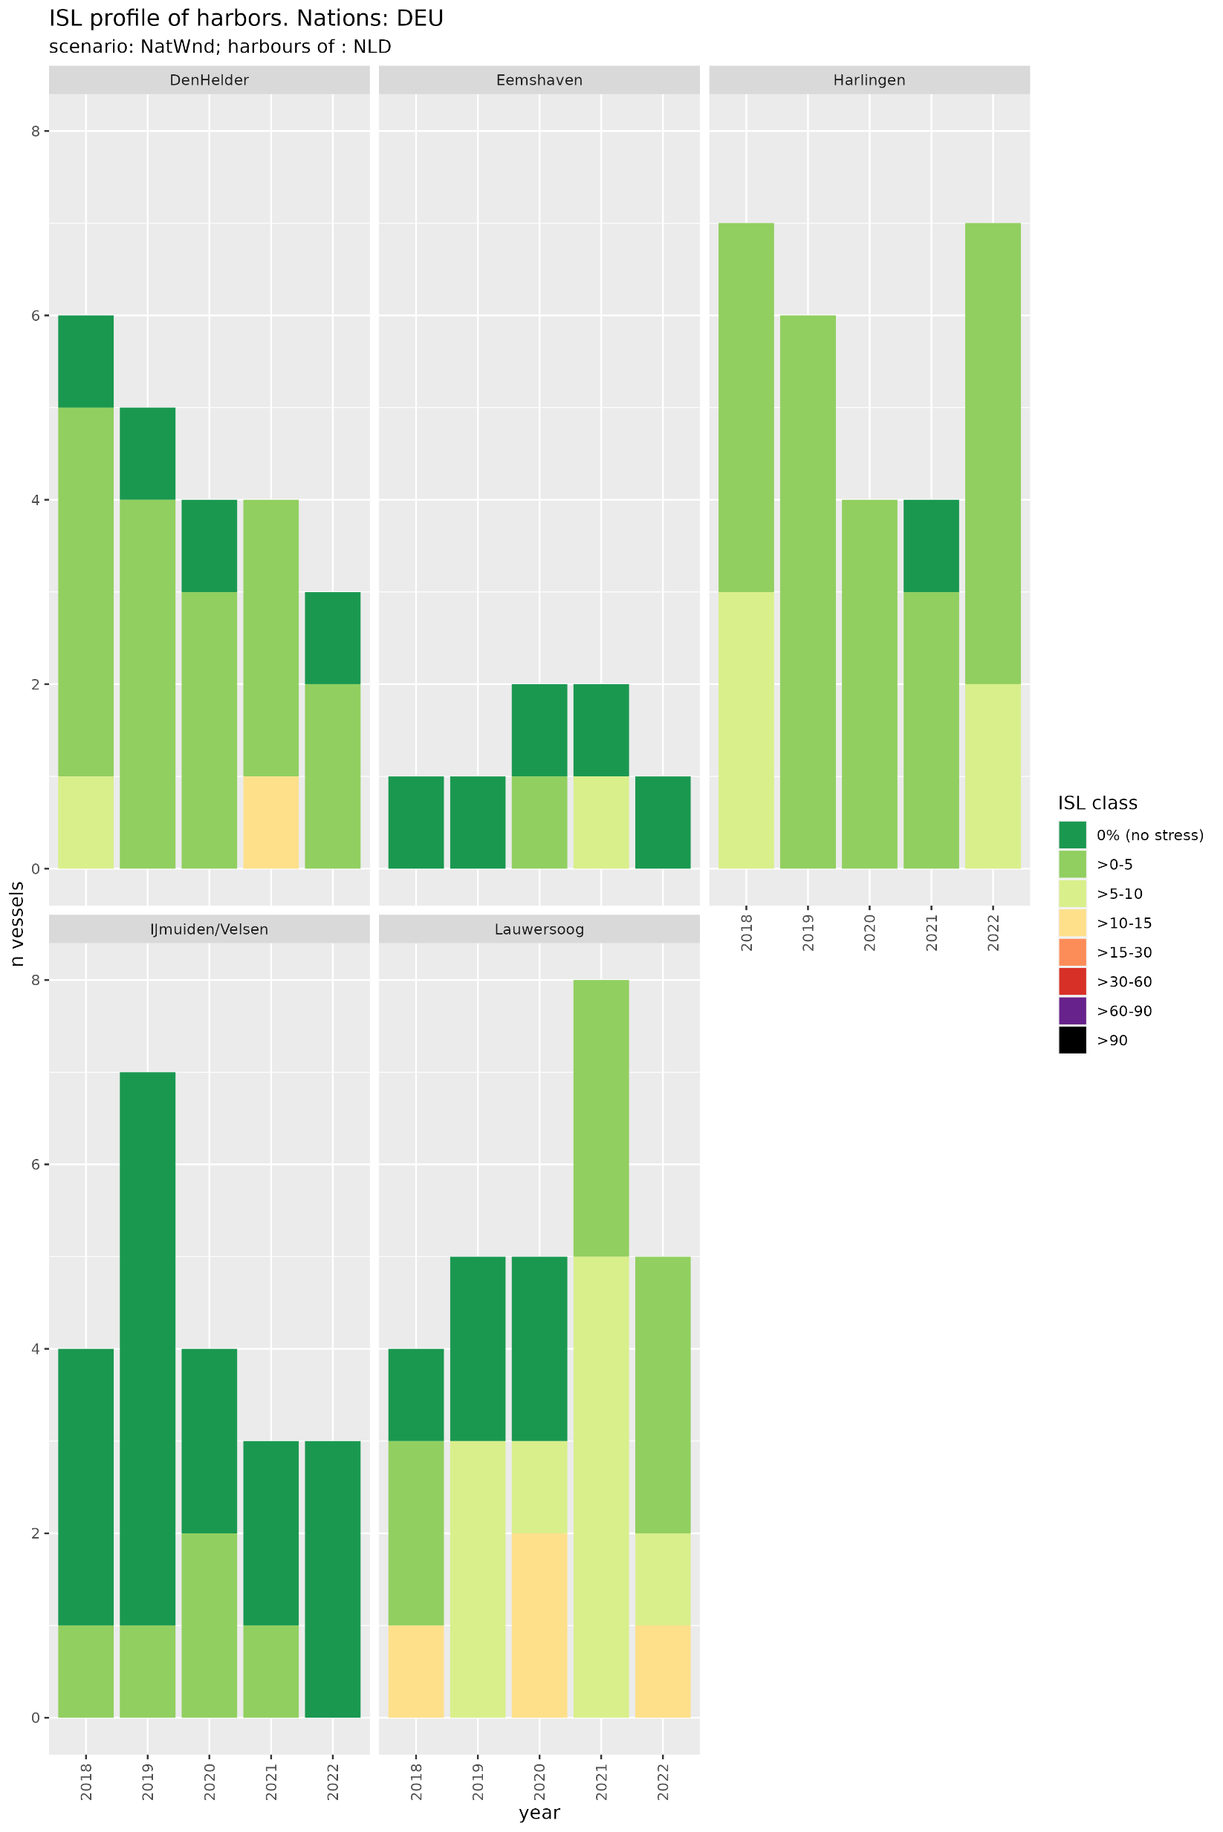
Individual Stress Level profiles of harbours
34 most important ports
NatWnd
Example ports of the Netherlands
NatWnd
Actual Home Port:
Port with the highest value of landings of a vessel
(not registered home port)
n vessels
Ports affectedness varies considerably

Slide 15
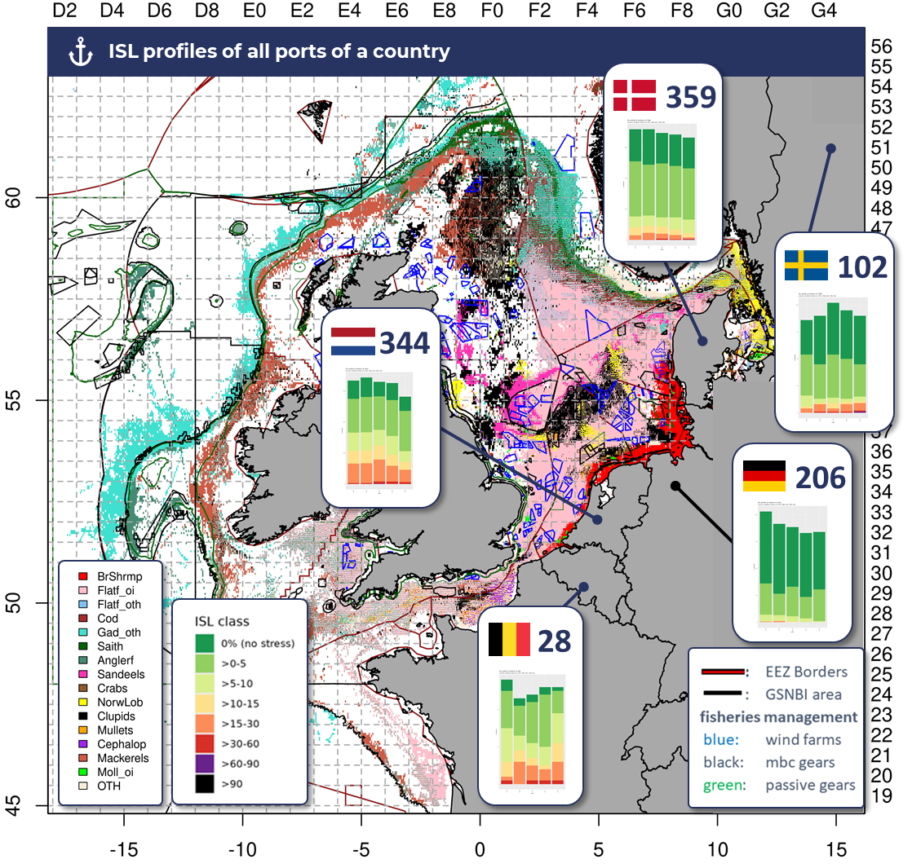
ISL
ISL profiles of all ports of a country
„Fleet of five“
Scenario: NatWind
Years: 2018-22
Tree Plot Map: Propotional catch revenues of species
Actual home port: port with highest landings of a vessel
Numbers in diagrams:
~ N vessels max
Differences between national coastal areas
Higher ISL values for Dutch ports

Slide 16
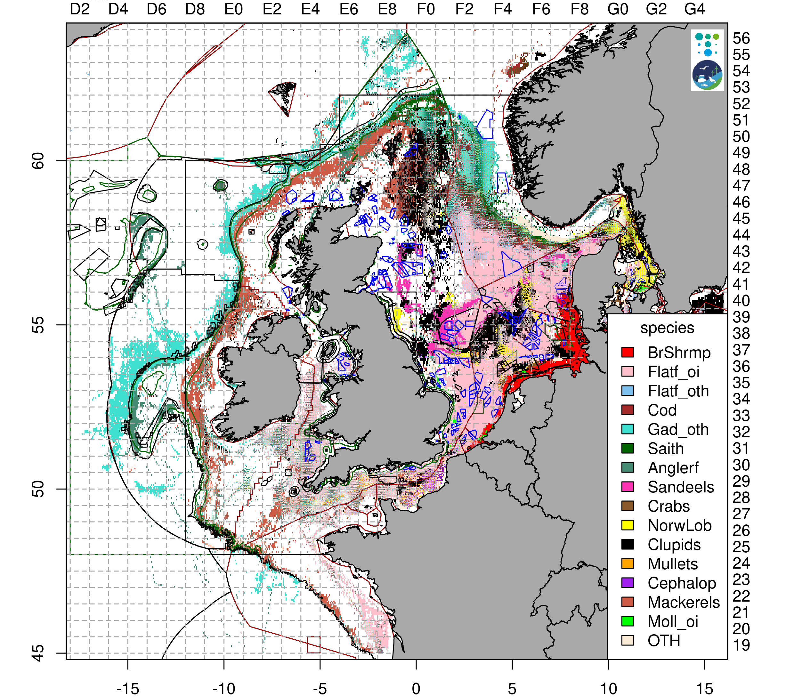
Stress Level species
unit | Scenario | Brown shrimp | Flatfish of interest | Flatfish others | Cod | Gadoids others | Saith | Anglerfish | Sandeels | Crabs | Norway Lobster | Clupeids | Mullets | Cephalo-pods | Mackerels | Molluscs of interest | others
Catch, mean y⁻¹ (kg) | NatPrt | 623 315 | 1 575 352 | 271 094 | 135 141 | 290 156 | 45 642 | 669 721 | 14 574 391 | 42 648 | 217 380 | 4 246 014 | 72 959 | 33 976 | 557 443 | 153 193 | 420 500
 | Wind | 44 016 | 3 619 137 | 469 465 | 25 891 | 375 038 | 4 935 | 41 679 | 9 399 300 | 58 887 | 196 699 | 16 229 320 | 38 710 | 19 491 | 2 287 000 | 53 402 | 666 371
 | NatWnd | 667 330 | 5 113 254 | 722 134 | 160 148 | 646 449 | 50 483 | 711 040 | 21 711 371 | 100 783 | 414 061 | 20 440 701 | 110 660 | 51 132 | 2 777 225 | 204 688 | 1 061 596
SL catch (%) | NatPrt | 2.09 | 3.33 | 1.61 | 0.68 | 0.15 | 0.35 | 14.16 | 10.74 | 4.48 | 2.6 | 0.81 | 4.73 | 2.39 | 0.48 | 0.88 | 0.31
 | Wind | 0.15 | 7.65 | 2.79 | 0.13 | 0.2 | 0.04 | 0.88 | 6.92 | 6.19 | 2.36 | 3.11 | 2.51 | 1.37 | 1.95 | 0.31 | 0.49
 | NatWnd | 2.24 | 10.81 | 4.3 | 0.81 | 0.34 | 0.39 | 15.04 | 15.99 | 10.59 | 4.96 | 3.92 | 7.18 | 3.6 | 2.37 | 1.18 | 0.78

Slide 17
Stress Level species
unit | Scenario | Brown shrimp | Flatfish of interest | Flatfish others | Cod | Gadoids others | Saith | Anglerfish | Sandeels | Crabs | Norway Lobster | Clupeids | Mullets | Cephalo-pods | Mackerels | Molluscs of interest | others
Catch, mean y⁻¹ (kg) | NatPrt | 623 315 | 1 575 352 | 271 094 | 135 141 | 290 156 | 45 642 | 669 721 | 14 574 391 | 42 648 | 217 380 | 4 246 014 | 72 959 | 33 976 | 557 443 | 153 193 | 420 500
 | Wind | 44 016 | 3 619 137 | 469 465 | 25 891 | 375 038 | 4 935 | 41 679 | 9 399 300 | 58 887 | 196 699 | 16 229 320 | 38 710 | 19 491 | 2 287 000 | 53 402 | 666 371
 | NatWnd | 667 330 | 5 113 254 | 722 134 | 160 148 | 646 449 | 50 483 | 711 040 | 21 711 371 | 100 783 | 414 061 | 20 440 701 | 110 660 | 51 132 | 2 777 225 | 204 688 | 1 061 596
SL catch (%) | NatPrt | 2.09 | 3.33 | 1.61 | 0.68 | 0.15 | 0.35 | 14.16 | 10.74 | 4.48 | 2.6 | 0.81 | 4.73 | 2.39 | 0.48 | 0.88 | 0.31
 | Wind | 0.15 | 7.65 | 2.79 | 0.13 | 0.2 | 0.04 | 0.88 | 6.92 | 6.19 | 2.36 | 3.11 | 2.51 | 1.37 | 1.95 | 0.31 | 0.49
 | NatWnd | 2.24 | 10.81 | 4.3 | 0.81 | 0.34 | 0.39 | 15.04 | 15.99 | 10.59 | 4.96 | 3.92 | 7.18 | 3.6 | 2.37 | 1.18 | 0.78
High SL of species for
Flatfish of interest (sole, plaice, turbot)
anglerfish
sandeels
crabs (lobster, rock crab)

Slide 18
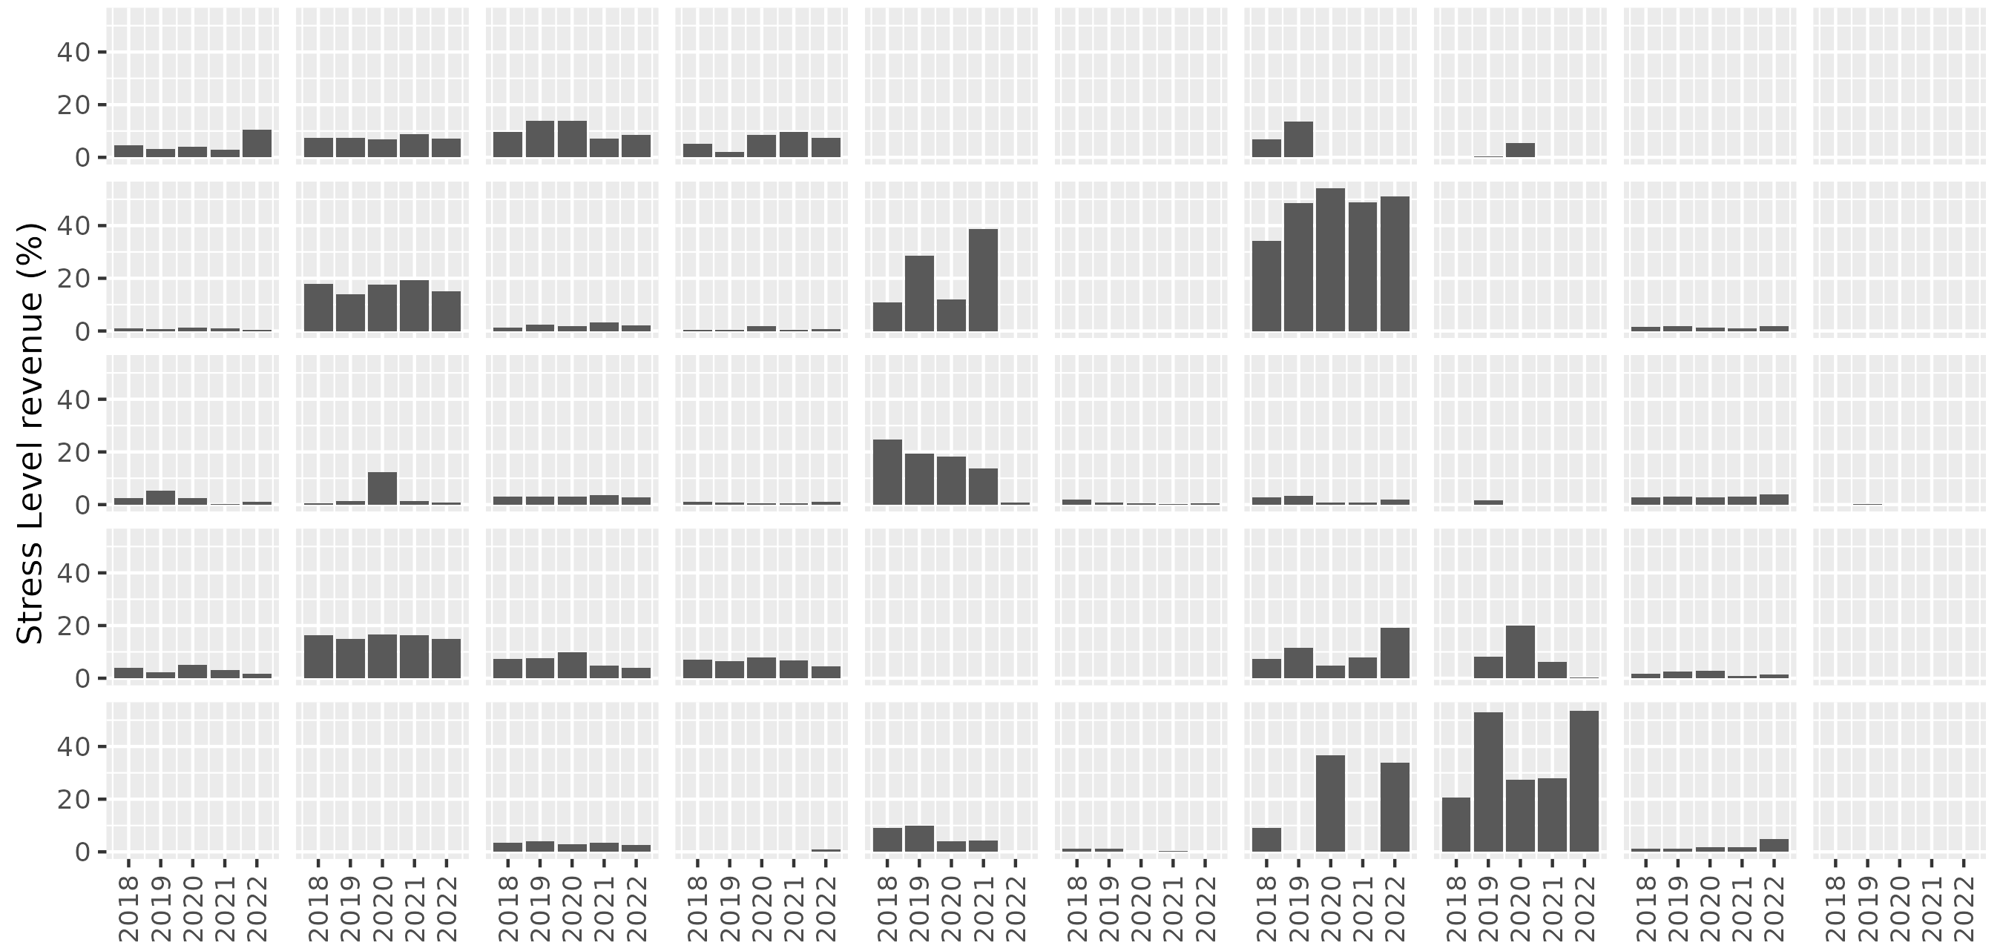
Differences between national fleets
Stress Level diagram per specific fisheries (gear types)
Impact on
TBC,TBB,DTD,DSN
TBB, PGE (SAN)
SAN
TBB, DTD, DSN, PGE
SAN,PGO (PGE)
Scenario: NatWnd
specific fisheries
N vessels
TBB targetting
C.crangon
Trawls Bottom
Beam remaining
Demersal Trawls
and Dredges
Demersal
SeiNes
SANdeel
fishery
PANdalus
fishery
Passive Gears
Entangling
Passive Gears
Others
Pelagic Trawls
and Seines
all OTHer
gears
BEL 78
DEU 238
DNK 376
NLD 374
SWE 113
25
63
24
6
3
1
NA
NA
NA
NA
180
69
49
4
2
5
12
6
NA
6
27
10
285
37
98
12
54
10
99
42
220
148
76
24
13
9
14
3
NA
NA
98
1
14
58
1
5
26
41
NA
NA
Please note in SL:
one vessel can perform several activities
Numbers in diagrams: N vessels perfoming this activity
NA: not available (no observations)

Slide 19
Differences between national fleets
Stress Level diagram per specific fisheries
Scenario: NatWnd
specific fisheries
Impact on
TBC,TBB,DTD,DSN
TBB, PGE (SAN)
SAN
TBB, DTD, DSN, PGE
SAN,PGO (PGE)
N vessels
TBB targetting
C.crangon
Trawls Bottom
Beam remaining
Demersal Trawls
and Dredges
Demersal
SeiNes
SANdeel
fishery
PANdalus
fishery
Passive Gears
Entangling
Passive Gears
Others
Pelagic Trawls
and Seines
all OTHer
gears
BEL 78
DEU 238
DNK 376
NLD 374
SWE 113
25
63
24
6
3
1
NA
NA
NA
NA
180
69
49
4
2
5
12
6
NA
6
27
10
285
37
98
12
54
10
99
42
220
148
76
24
13
9
14
3
NA
NA
98
1
14
58
1
5
26
41
NA
NA
Please note in SL:
one vessel can perform several activities
Numbers in diagrams: N vessels perfoming this activity
NA: not available (no observations)

Slide 20
Summary
Snapshot in time: We use designations from 2023 (cut-off date) and fisheries data of 2018-2022
Displacement is seen due to major events (e.g. Brexit has an influence on SL esp. in sand eel fisheries), also after the cut-off date
Considerable variations of SL between specific fisheries, species, and national fleets
Even with fleets of low SL, often several single vessels strongly affected (high ISL)
Large variation of affectedness also for coastal communities (ports)
Hot-spots (e.g. waters between BE, NL and UK) of spatial challenge identified
Results might be an underestimation (not all spatial pressures included,) and a rise in stress level to be expected after new designations both before and after 2030 with e.g. more wind energy or new MPA development.
Results are not profit lost, since variable costs, displacement and use of alternative areas are not considered.
Study proves that for correct assessment, transboundary, basin-wide and cumulative appraisal is indispensable
Regular study update essential for fisheries inclusion in MSP → Concept paper WT LTFP

Slide 21
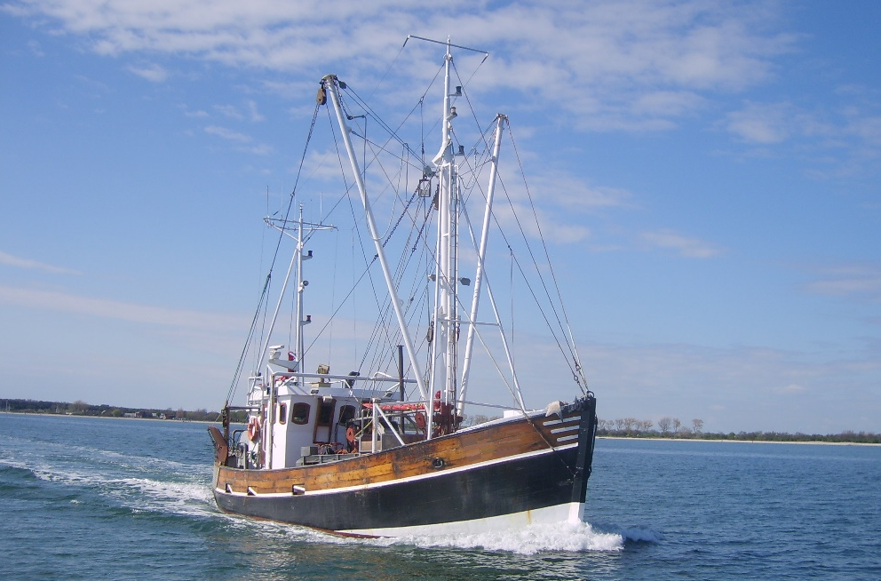






Thank You for Listening
Johann Heinrich von Thünen-Institute
Federal Research Institute for Rural Areas, Forestry and Fisheries
Institute of Sea Fisheries
Herwigstraße 31
27572 Bremerhaven
Germany
Dr. Torsten Schulze
Email: Torsten.Schulze@thuenen.de
phone: +49 (0)471 94460 382
Dr. Casper Kraan
Email: Casper.Kraan@thuenen.de
Phone: +49 (0)471 94460 229
Further authors:
Katell Hamon, Lennert van de Pol
Jeppe Olson
Patrik Jonsson
Klaas Sys
Tobias Lasner
Instituut voor Landbouw-, Visserij- en Voedingsonderzoek
With support of many GNSBI ministries, agencies and assistance mechanism, EU commission, …..

