Slide 1
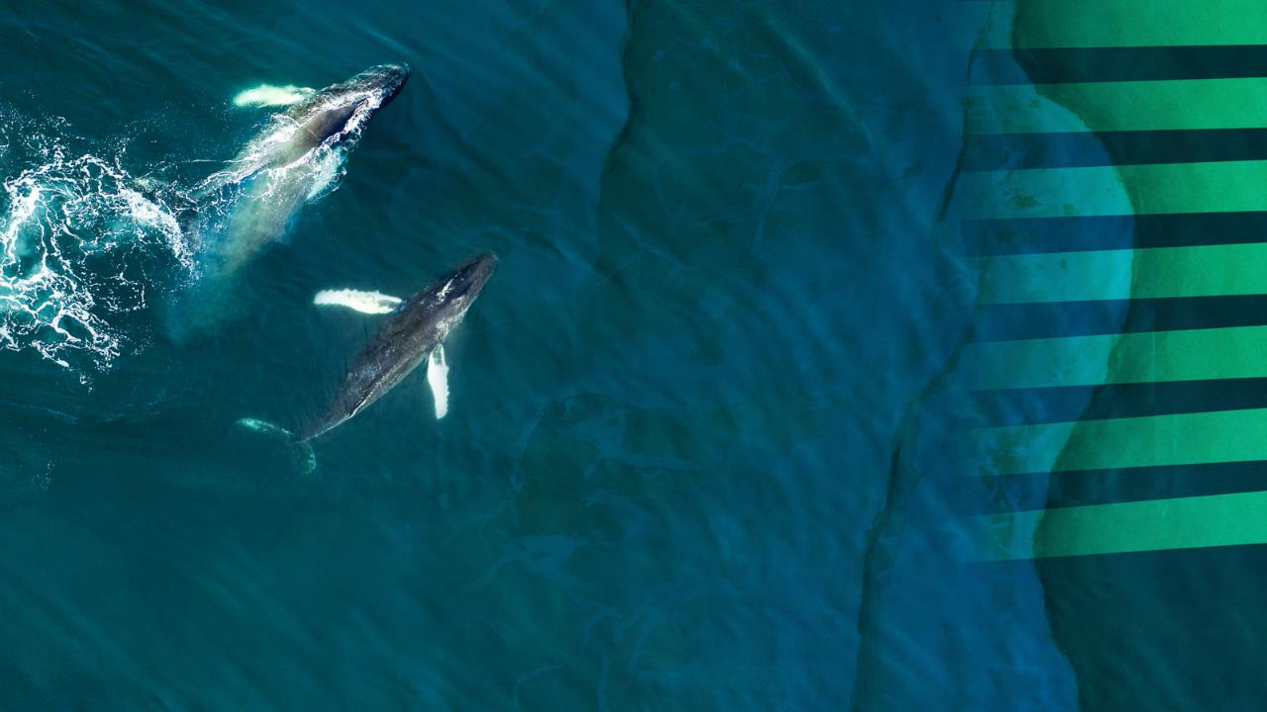


The European Ocean Pact
Sustaining the ocean that sustains us

Slide 2



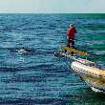
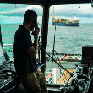
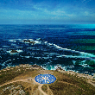
Protecting and restoring ocean health
Boosting competitiveness of the sustainable blue economy
Supporting coastal, island and outermost regions
6 PRIORITIES
Strengthening EU ocean diplomacy and international governance.
Enhancing maritime security and defence
Advancing ocean research, knowledge, skills and innovation

Slide 3


A strong governance framework is needed to align actions at Union, regional, national, and local levels through the various sea basins, involving both EU and non-EU countries.

Slide 4
Strengthened Governance Framework
Building on a revision of the MSP Directive
Strengthening and modernising maritime spatial planning to serve the priorities of the Ocean Pact
Working towards simplifying and synchronising ocean-related reporting obligations for Member States in existing legislation
Notes:
What the Ocean Pact says about the Ocean Act

Slide 5
The European Ocean Act
Legislation, Implementation, Simplification

Slide 6
“Ocean Act” - key elements (1)
Serve the six priorities of the European Ocean Pact
Reference relevant targets – making them future-proof beyond 2030
Revision of the MSP Directive – strengthen MSP towards a) increased cross-sectoral coordination at national level, b) better organised sea basin approach, early and continuous dialogue on maritime spatial planning, c) making MSP “climate-smart”
Increase coherence and alignment with the Marine Strategy Framework Directive
Notes:
The legislative proposal for an Ocean Act will build on the revision of the MSPD and aim at ensuring an integrated and ecosystem-based approach to spatial planning. It will seek to reinforce policy coherence with the MSFD, with sector-based policy, and strengthen sea basin cooperation.
The Ocean Act will serve the 6 priorities of the Ocean Pact and their implementation. It will reference relevant targets, so that they are identifiable under one roof, and will facilitate their coherent and effective implementation. It will ensure (e.g. through a dynamic legal reference) that any legislative developments on targets related to those in the Ocean Pact is not hampered by the provisions of the Ocean Act.
The Commission is currently running an evaluation and impact assessment study of the MSPD, which will assess the impacts of different options.
In parallel, the Commission is preparing an impact assessment on the MSFD revision. The revised MSFD will introduce targets, reduce administrative burden, improve synergies within the environmental acquis, strengthen the ecosystem-based approach, the governance framework for environmental protection and regional cooperation.
The Commission will engage with stakeholders with two coordinated calls for evidence and targeted consultations, which will guide next steps and the revision of the two Directives.

Slide 7
“Ocean Act” - key elements (2)
Proposal for Ocean Observation governance and coordination
Facilitate coherent and effective implementation of targets – simplification / synchronization of reporting obligations
Clarify Ocean Pact Governance, together with high-level Ocean Board, Ocean Pact Dashboard, Reporting
Notes:
The landscape of ocean observation across Member States is fragmented between different institutions. Plans and programs are causing inefficiencies, duplication of efforts, lost collaboration opportunities, missed chances for cost-effective, integrated action.
A coherent European approach requires a structured governance and coordination for Ocean Observation involving the European Commission and the Member States
The Ocean Act will contribue to the governance of this initiative through:
Establishing a governance for an integrated, high-tech, cost effective, reliable and secure European ocean observation system
Establishing a process to create a coherent and standardized approach to planning and conducting ocean observation campaigns by 2027

Slide 8






“Ocean Act” – reference targets (examples)
Ensure conservation of marine biological resources and management of fisheries.
Achieve the goals of the Common Fisheries Policy (CFP)
Achieve Good environmental status (GES) of marine waters by 2020.
Monitor and assess bathing water
MARINE WATERS
River Basin Management Plans (RBMPs) and Programmes of Measures to achieve good chemical and ecological status)
Reduce and monitor water pollution caused by nitrates used in agriculture
FISHERIES
CLIMATE &
ENERGY
Climate-neutrality in the EU by 2050
MS cooperate on goals for offshore renewable generation to be deployed within each sea basin by 2050
FRESHWATER
SHIPPING
Shore-side electricity supply for certain vessels
Inventory of Hazardous Materials - EU list of ship recycling facilities.
Maximum limits for yearly average GHG intensity of energy used by ships.
Passenger and container ships to use on-shore power supply (OPS) or alternative zero-emission technologies.
Special Emission Control Areas / Pollution control zones
LAND
& SEA
Natura 2000 network of protected sites.
Restore at least 30% of the EU’s degraded sea areas by 2030, all ecosystems in need of restoration by 2050. Submit National Restoration Plans by mid-2026.
Ban certain single-use plastic items.

Slide 9
“Ocean Act” – ocean observation
Key Objective: MS Coordination, transparent planning of activities, understanding of needs, gaps and overlaps, increased collaboration, EU-MS management structure
planning optimisation, digitalisation & simplification across legal obligations, reduction of burden, identification of gaps, reduction of observing costs, etc
OO coordination and governance will create the necessary foundation for a sustained and efficient European Ocean Observing System
create the conditions for joint procurement of OO technologies → reduction of cost for MS, support of the EU market
the Ocean Act, in support of the overall Ocean Observation initiative, will facilitate the use of the existing marine knowledge assets (Copernicus Marine, EMODnet, WiseMarine) for simplification & reduction of burden, while addressing the need for OO autonomy, together with the Member States.
Notes:
→ important that the work under the Ocean Act is well coordinated with revisions of MSFD to maximise synergies

Slide 10
“Ocean Act” – tentative timeline
MSPD Implementation dialogue, 1 July 2025
Call for Evidence, followed by open public consultation, January-April 2026
Targeted stakeholder consultations Q2 2025 - Q2 2026
2nd MSPD Implementation report, April 2026
Evaluation and Impact Assessment study, November 2025-June 2026
Legislative proposal, December 2026
Notes:
Discussion in Member States Expert Group on MSP 23-24 October
Hearing in the European Parliament “Securing Grounds for Sustainable Fishing and Aquaculture in the Competition for Marine Space”; 11 November 2025; INI report: “Evaluation of the Impact of the Implementation of the Maritime Spatial Planning Directive 2014/89/EU on Fisheries in Selected Fishing Areas and Sea Basins”

Slide 11
Thank you
© European Union 2025
Unless otherwise noted the reuse of this presentation is authorised under the CC BY 4.0 license. For any use or reproduction of elements that are not owned by the EU, permission may need to be sought directly from the respective right holders.
Source: Adobe.stock.com

