Slide 1


HORIZONTAL WORKING GROUP
05 March 2026
www.nwwac.org

Slide 2
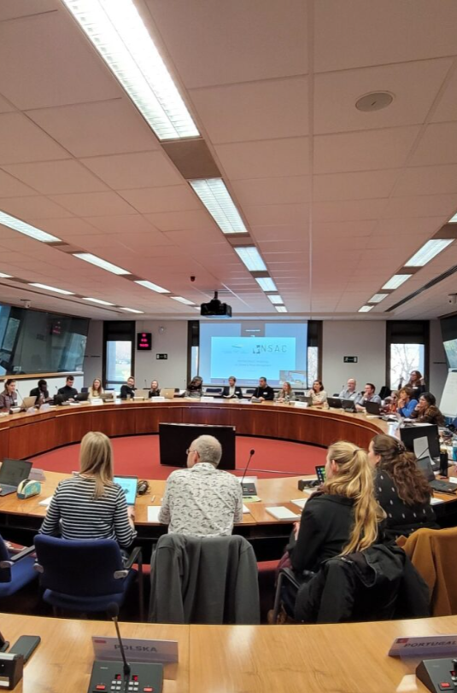

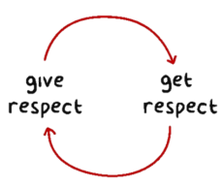
North Western Waters Advisory Council
North Western Waters Advisory Council
Meeting etiquette
Please arrive on time so we can dive straight into the agenda.
Listen actively: Give speakers your full attention, avoid side conversations or interrupting.
Create a supportive environment: Be respectful, value diverse opinions and use inclusive language.
Treat people fairly, promote an integrated way of working and respect the dignity of members at all times.
Use discretion and respect others. Harassment, bullying, intimidation or discrimination in any form are unacceptable.

Slide 3
Agenda
North Western Waters Advisory Council

Slide 4
Action points from the last meeting
1 | Members to send queries following the Commission’s presentation to the Secretariat.
2 | Members to send queries following the ILIAD project presentation to the Secretariat.
3 | Members to send queries following the IMBUS project presentation to the Secretariat.
4 | Secretariat to send information on IMBUS project to Working Groups and ask for input regarding priorities for the project.
5 | Secretariat to add standing agenda item to HWG agendas on review of advice submitted and responses received.
6 | NWWAC to add query regarding which forum UK MPA designation is discussed to Inter-AC Brexit agenda.
North Western Waters Advisory Council

Slide 5
Action points from the last meeting
7 | NWWAC to raise query on guidance on the “Do No Significant Harm principle” announced in the Commission’s proposal on MFF 2028-2034 in the upcoming Inter-AC meeting.
8 | Secretariat to ask for expressions of interest for participation in Advice Drafting Group on small-scale fisheries.
9 | Working Groups to add standing agenda item on small-scale fisheries.
North Western Waters Advisory Council

Slide 6
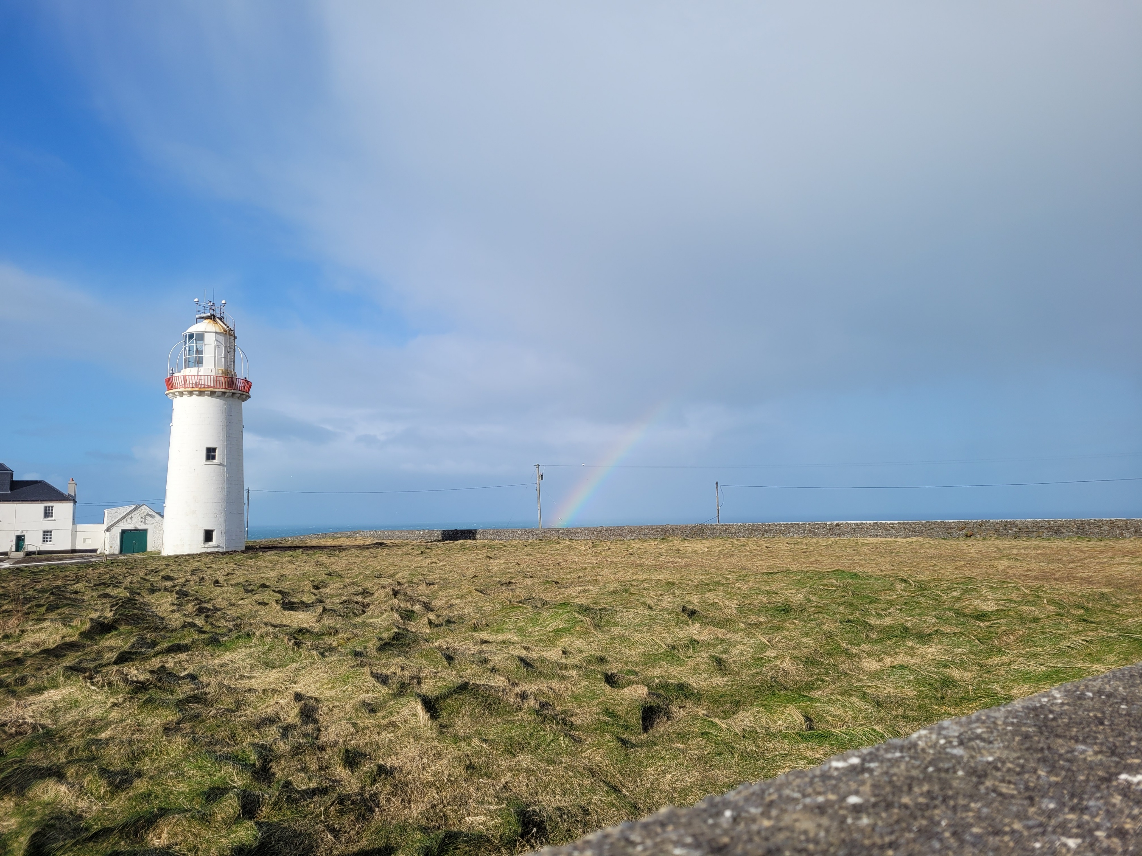
North Western Waters Advisory Council
2 Update from the PECH Committee – Carmen Crespo Diz, Chair of the PECH Committee (tbc)
3 Atlantic Strategy - Rosa Bernardo, Atlantic Spanish Presidency

Slide 7
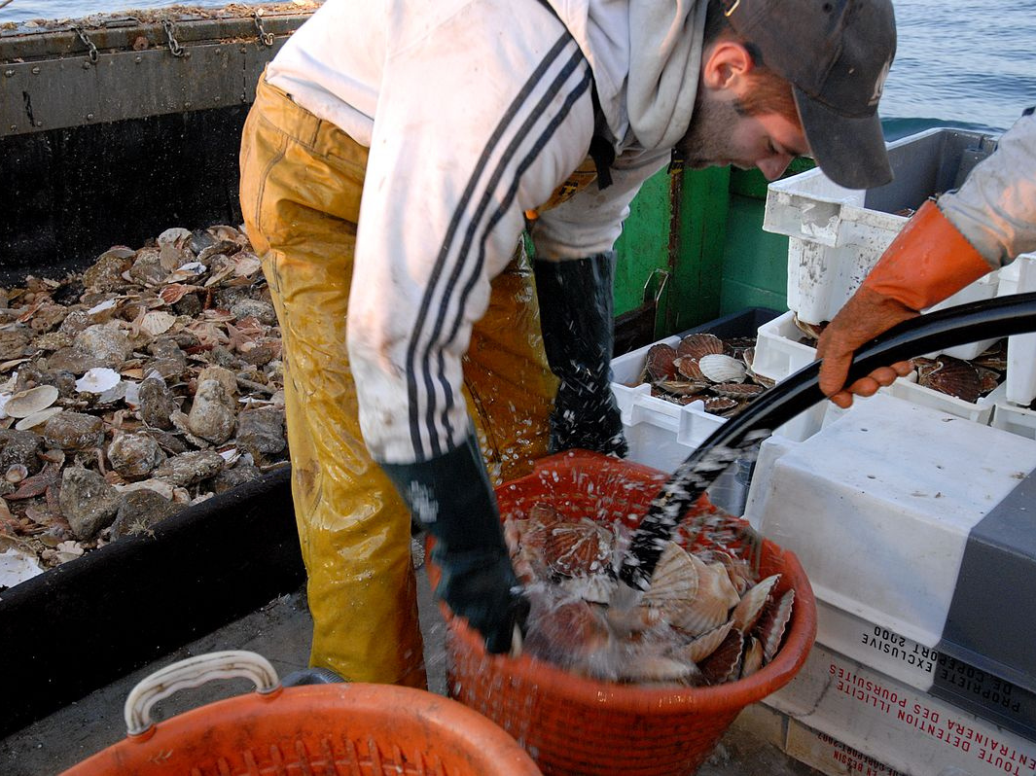

North Western Waters Advisory Council
LUNCH
13:00 – 14:00 CET

Slide 8
North Western Waters Advisory Council
4 Greater North Sea Basin Initiative – Manuela Zajk, Ministry of Agriculture, Fisheries, Food Security &
Nature, The Netherlands
5 Update on the MSP Directive evaluation – Felix Leinemann, DG MARE Head of Unit MREA A.2
6 Dialogue with the Cyprus presidency of the Council of the EU – Yiannos Kyriacou, Fisheries Counsellor, Permanent Representation of the Republic of Cyprus to the EU

Slide 9
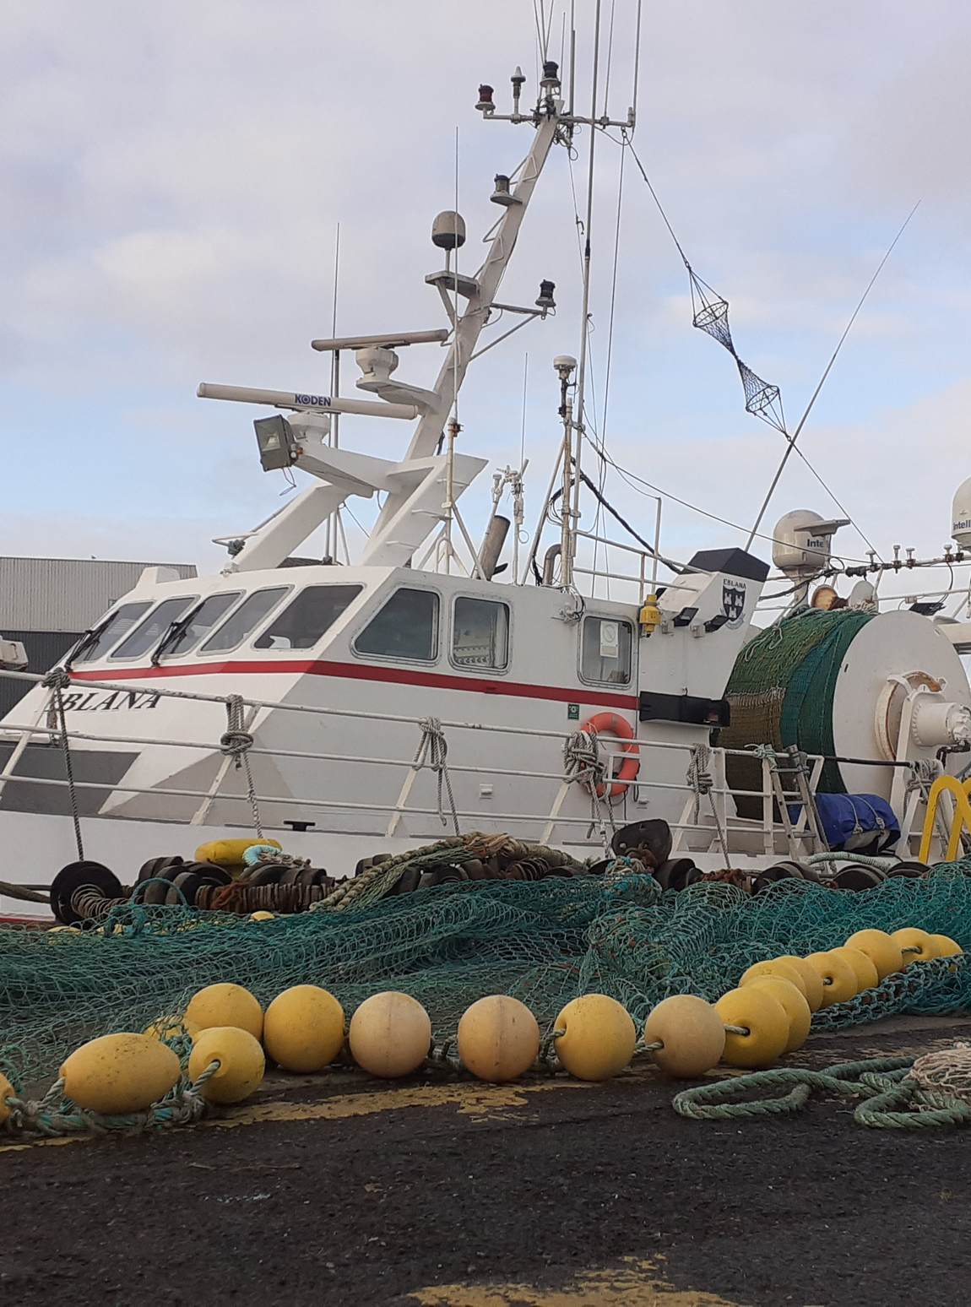
North Western Waters Advisory Council
North Western Waters Advisory Council
7. Focus Group update
Inter-AC Brexit Forum
CFP
Landing Obligation
Climate & Environment
Crab
Skates & Rays
Scallops
Seabass
Whelk
Control & Compliance
Social Aspects
Spatial Dimension

Slide 10
Inter-AC Brexit Forum
Established between PelAC, NWWAC, NSAC, LDAC and CCRUP
1 meeting in Year 21:
21 October 2025 chaired by the NWWAC
Commission attendance and updates (confidential)
SCF decision from 19 June 2025
Topics at SCF:
Marine Protected Areas (MPAs)
Fisheries Management and Conservation: MAPs with focus on Celtic Sea; Measures for recreational activity on Pollock, skates & rays management, sea bass, brown crab
REM measures in UK waters
multi-year strategy for King scallop
Next meeting: 13 March (online) organised by the NSAC
North Western Waters Advisory Council

Slide 11

CFP
Chair Alexandra Philippe
Vice-Chair Manu Kelberine
Last meeting: 26 March 2025
NWWAC response - European Ocean Act: Call for evidence, submitted 03 February – no response expected
Proposed NWWAC advice: Vision 2040 call for evidence (link)
Next meeting: tba
North Western Waters Advisory Council

Slide 12

Landing Obligation
Chair Emiel Brouckaert
Last meeting 26 November 2025
NWWAC advice on Commission Communication COM(2025) 296 and on ICES latest advice submitted 29 August 2025
Joint NWWAC/NSAC advice on the European Commission “Study supporting the evaluation of the landing obligation”, response received
Next task:
Development of annual NWWAC choke advice
North Western Waters Advisory Council

Slide 13
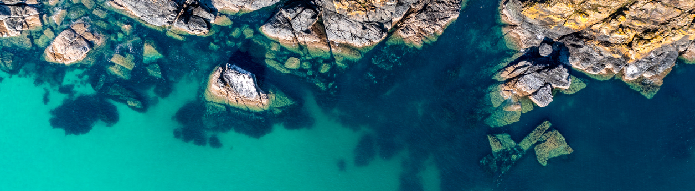
Climate & Environment
Chair Alexandra Philippe
Last meeting 15 December 2025
NWWAC advice on the Energy Transition Partnership delivered 19 June 2025, follow up advice to be delivered by 31 October, final workshop held 17 February 2026, Brussels
NWWAC Advice on the Marine Strategy Framework Directive - Call for Evidence - in the North Western Waters (NWW), submitted 11 February, no response expected
NWWAC Advice on the Marine Strategy Framework Directive - Call for Evidence - in the North Western Waters (NWW), also submitted in response to Trinomics/Milieu survey on 23 February.
Next meeting tbc
North Western Waters Advisory Council

Slide 14
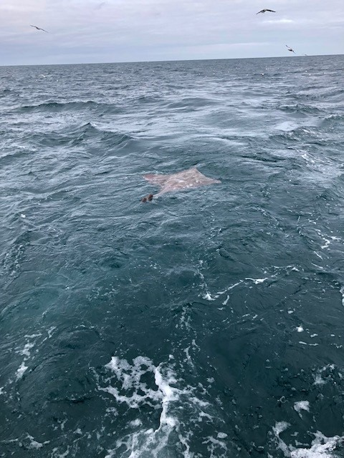
Joint NWWAC/NSAC
Focus Group Skates & Rays
Led by the NWWAC
Chair John Lynch
Last meeting 02 March 2026
NWWAC/NSAC advice on skates and rays management submitted 28 October 2026, response received 19 November 2025
Next meeting: tba

Slide 15
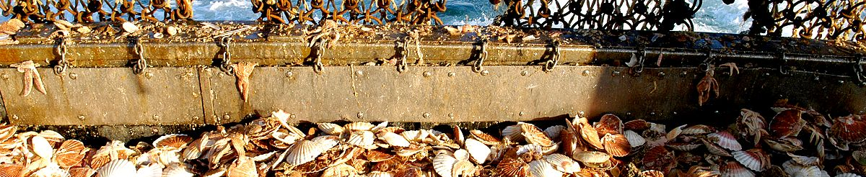
Scallops
Chair Mathieu Vimard; Vice Chair John Lynch
Last meeting 04 December 2025
NWWAC Letter to the NWW MSG on “Amendment to the Technical Measures Regulation for reopening the Channel scallop stock recovery area on the first Monday after 15 October” submitted on 10 February, currently being discussed by the NWW MS TG
Stay informed on the EU-UK Multi Year Strategy on King Scallop – waiting for the scientific report
Planned workshop (date TBD) divided in two parts to discuss a joint approach for management measures:
First session: meeting between French and Irish stakeholders
Second session: meeting between French, Irish and UK stakeholders
North Western Waters Advisory Council

Slide 16
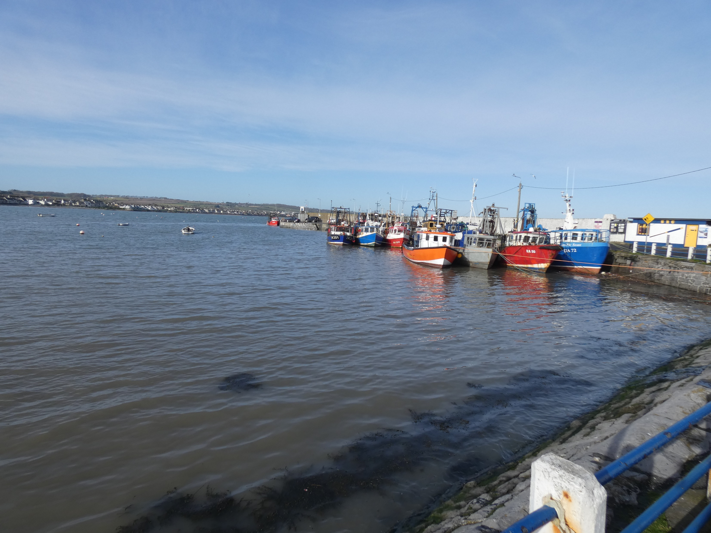
North Western Waters Advisory Council
North Western Waters Advisory Council
Seabass
Chair – To be appointed
Vice-Chair Manu Kelberine
Last meeting: 05 September 2025
NWWAC advice on management measures for seabass for 2026, response received
Next meeting: tba

Slide 17
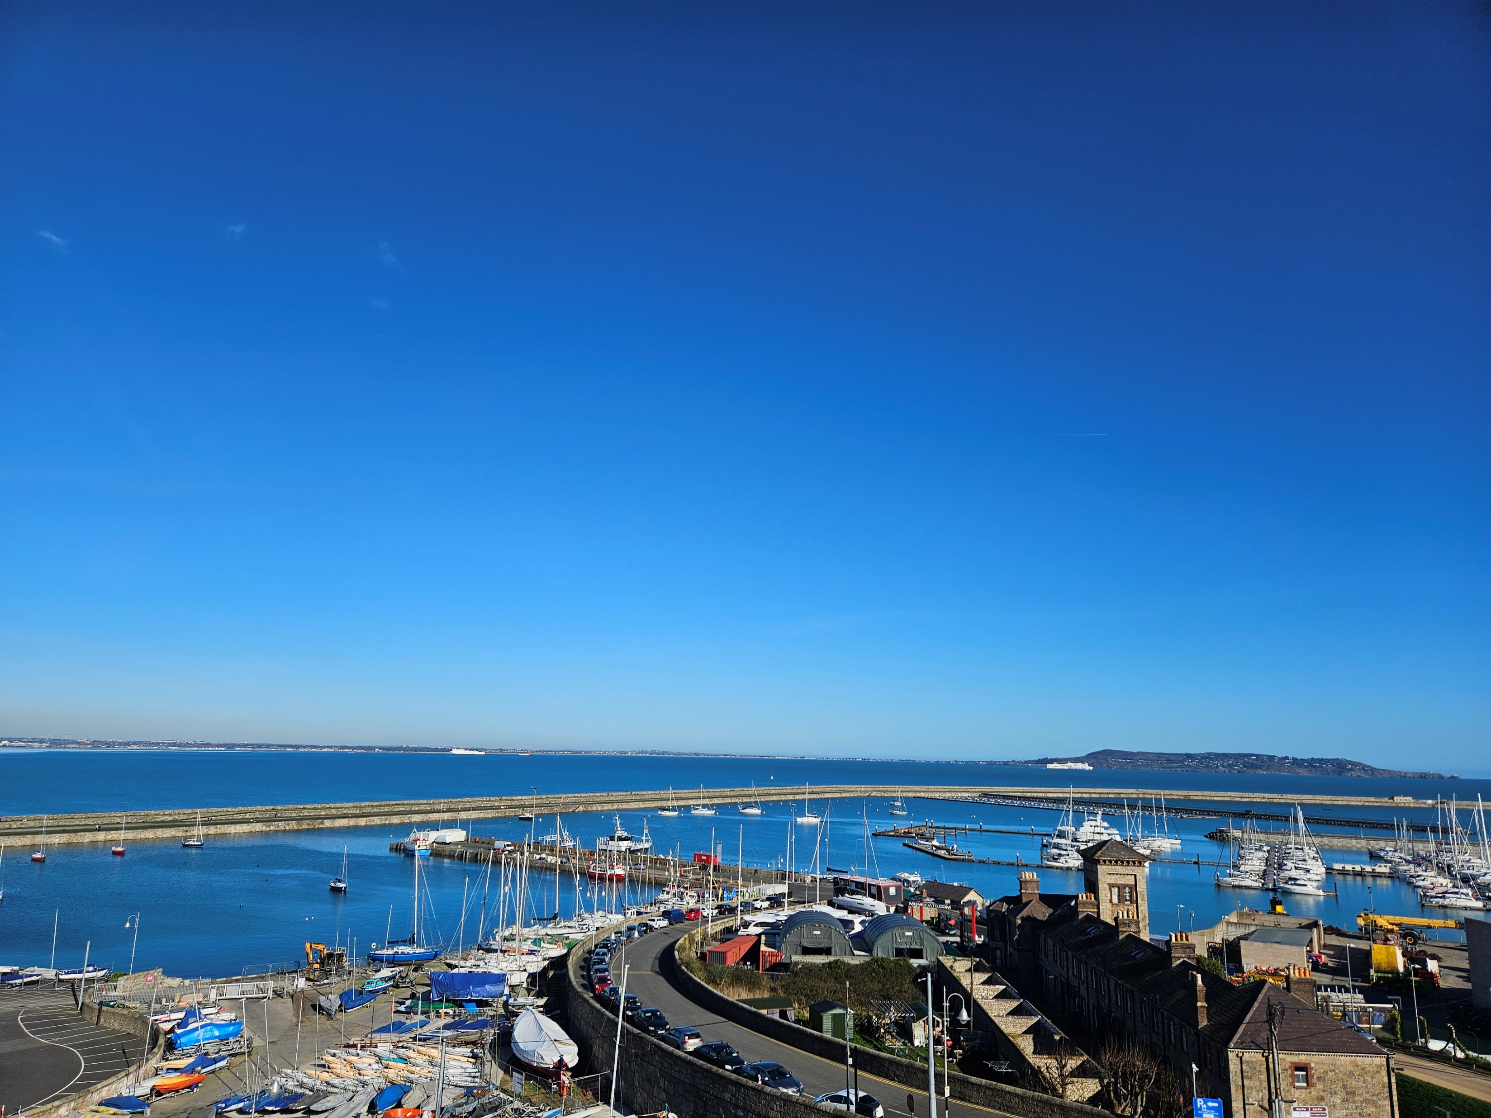
North Western Waters Advisory Council
Whelk
Chair Alexandre Leclerc
Last meeting: 23 October 2025
The FG Whelk was reactivated in 2025 in light of recent scientific developments and new data.
The FG will follow the work of the ICES Working Group on Whelk, to enable exchanges between scientists and FG members to assess whether sufficient data are now available to again request that the Commission put management measures in place for EU waters, and to consider further engagement with the UK through the Specialised Committee on Fisheries.
Next meeting: currently being organised.

Slide 18
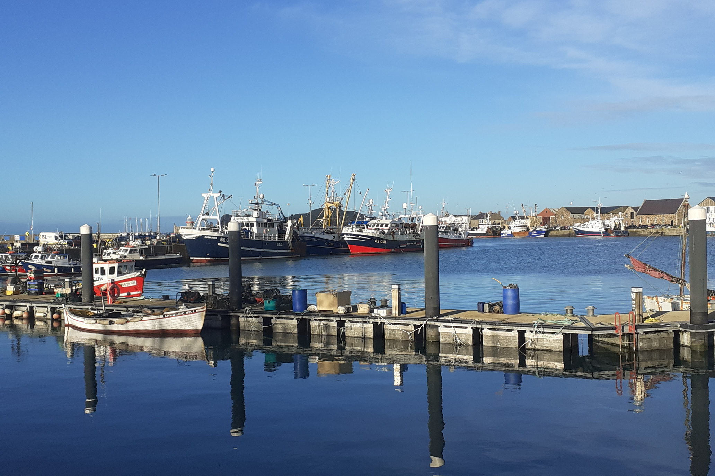
Focus Group Control, Enforcement & Compliance
Chair Patrick Murphy; Vice-chair Arthur Yon
Last meeting on 08 September
Joint NWWAC – PelAC – NSAC advice on the Control Regulation submitted 23 May, response received – but: no direct response to the Multi-AC queries to DG MARE following workshop on 20 February.
Joint ACs Letter on stakeholder consultation related to the implementation of Control Regulation, response received
NWWAC Advice on the recent Delegated Regulation related to Control Regulation and on boarding ladder measures, response received as email text
Joint request sent to MSG for meeting with Control Expert Group – TBD
Workshop on Control Regulation to be organised with DG MARE Control Unit the same day of the next InterAC - TBD
Next FG meeting: (add date)

Slide 19
Joint NSAC/NWWAC Focus Group Social Aspects
Led by NSAC since 01 October 2022
Chair candidate Alfred Fisker Hansen
Latest advice: NSAC/NWWAC advice on STECF Work on Social Data in Fisheries submitted 22 August 2025
Last meeting on 02 September 2025:
Presentation Baseline study on the training and certification requirements of fishers in the EU
Update on EU Blue Generational Renewal Strategy (Ocean Pact)
Discussion on taxation of fisheries incomes compared to other sectors
Report on NSAC/NWWAC websites
Next meeting XXX to discuss
STECF Social and Economic reports
ETP-Europeche project on occupational health, safety and attractiveness of fisheries sector
Fisheries taxation system
Discussion on potential advice
North Western Waters Advisory Council

Slide 20
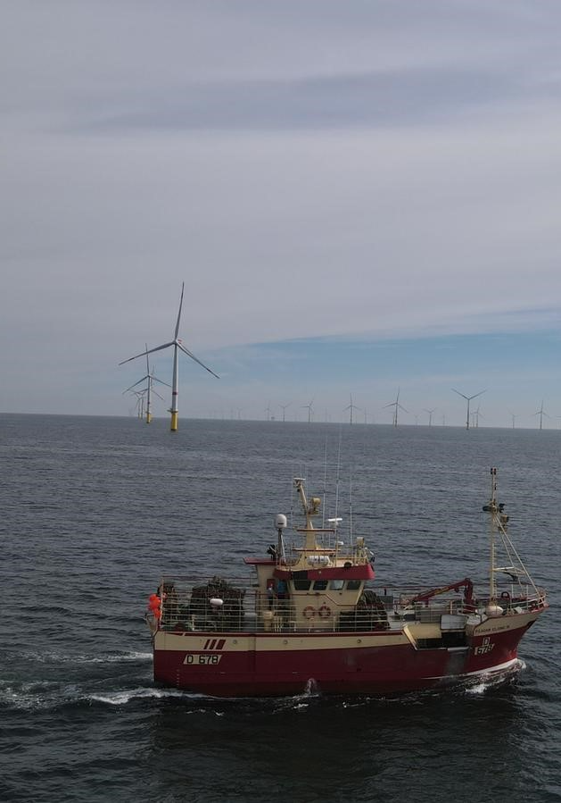
North Western Waters Advisory Council
Joint NWWAC/PelAC Focus Group Spatial Dimension
Chair Gonçalo Carvalho
Co-ordinated by the Pelagic AC
Last meeting 28 November 2025
Joint NWWAC/PelAC advice to the NWW Member States on renewable energy developments in the marine space submitted to Spanish presidency of NWW MSG 17 February 2025
Joint NWWAC/PelAC advice on ORE submitted 03 June, response received 31 October 2025
Next meeting tba

Slide 21
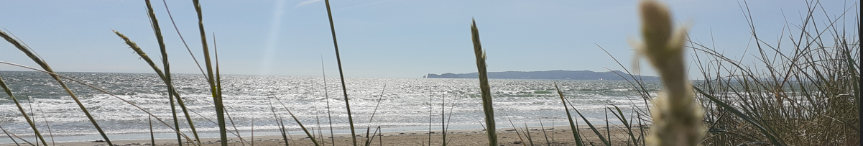
9. Review of advice submitted in Year 20/21
Date | Full title | Response from Commission
07/11/2024 | Joint ACs recommendation on Deep-Sea Mining and its impact on fisheries | Awaiting response
13/01/2025 | NWWAC advice Addressing Choke Risk in NWW after exemptions | Awaiting response
23/05/2025 | Joint NWWAC, PelAC and NSAC Advice on the implementation of the EU Fisheries Control Regulation | 05/02/2026
03/06/2025 | NWWAC/PelAC Advice on the impact of Offshore Renewable Energy Developments on commercial fisheries | 31/10/2025
20/06/2025 | NWWAC/PelAC advice on Sprat in the English Channel (ICES divisions 7.d and 7.e) | 04/09/2025
30/06/2025 | NWWAC Advice on the Vision for Agriculture and Food 2040 and the proposed Vision for Fisheries and Aquaculture 2040 | 23/10/2025
22/08/2025 | NSAC/NWWAC Advice on STECF Work on the Social Data in Fisheries | 22/10/2025
01/09/2025 | Joint AC Recommendations to Enhance the Role and Functioning of the EU Advisory Councils | Discussed at Inter-AC, no further response
16/10/2025 | NWWAC Advice on the Commission Delegated Regulation of 27.8.2025 related to Control Regulation and on Boarding Ladder Safety and Material Standards provisions | Awaiting response
North Western Waters Advisory Council

Slide 22
Review of advice submitted in Year 20/21
Date | Full title | Response from Commission
03/11/2025 | Joint ACs Letter "Towards improved consultation with Advisory Councils and stakeholders on Control Regulation" | 05/02/2026
16/12/2025 | NWWAC Advice on strengthening the role of the Advisory Councils in developing technical and remedial measures | 04/02/2026
18/12/2025 | Joint NWWAC/NSAC Advice on the European Commission “Study supporting the evaluation of the landing obligation” | Awaiting response
03/02/2026 | NWWAC response - European Ocean Act: Call for evidence | Receipt acknowledged, no further response as it is a public consultation
10/02/2026 | NWWAC Letter to the NWW MSG “Amendment to the Technical Measures Regulation for reopening the Channel scallop stock recovery area on the first Monday after 15 October" | Awaiting response
11/02/2025 | NWWAC Advice on the Marine Strategy Framework Directive - Call for Evidence - in the North Western Waters (NWW) | Awaiting response
North Western Waters Advisory Council

Slide 23
Review of advice submitted in Year 20/21 – possible actions
 | Full title
23/05/2025 | Joint NWWAC, PelAC and NSAC Advice on the implementation of the EU Fisheries Control Regulation
Action | Second workshop to be organised by ACs – currently in discussion with MARE D3 to hold this together with the planned Inter-AC meeting in May/June
03/06/2025 | NWWAC/PelAC Advice on the impact of Offshore Renewable Energy Developments on commercial fisheries
Action | To be followed up by PelAC/NWWAC Focus Group Spatial Dimensions
20/06/2025 | NWWAC/PelAC advice on Sprat in the English Channel (ICES divisions 7.d and 7.e)
Action | Scientific research being carried out – for PelAC to follow up?
30/06/2025 | NWWAC Advice on the Vision for Agriculture and Food 2040 and the proposed Vision for Fisheries and Aquaculture 2040
Action | Vision to be presented in second half of 2026 – further NWWAC work?
North Western Waters Advisory Council

Slide 24
 | Full title
22/08/2025 | NSAC/NWWAC Advice on STECF Work on the Social Data in Fisheries
Action | Publication of first social report following STECF March plenary – reflection in collaboration with the ACs – what format will this take? To be followed up by NSAC/NWWAC Focus Group Social Aspects
03/11/2025 | Joint ACs Letter "Towards improved consultation with Advisory Councils and stakeholders on Control Regulation"
Action | COM expects engagement at MS level Revised Control Regulation cannot be modified Targeted workshop welcome
16/12/2025 | NWWAC Advice on strengthening the role of the Advisory Councils in developing technical and remedial measures
Action | The Commission remains open to improving the way engagement is conducted and encourages MS to engage with ACs as early as possible when developing JR. The Commission to present the outcome of the EU-UK consultations to ACs.
Request from DG MARE: Discussion on how to engage more meaningfully with the Commission without adding unnecessary pressure on resources.
North Western Waters Advisory Council

Slide 25

AOB. Internal AC communication
LinkedIn NWWAC Member Spotlight Campaign → Questionnaire to provide information about your organisation : https://forms.gle/wzxkm9fDg2QXKV1eA
NWWAC WhatsApp Group:
North Western Waters Advisory Council

Slide 26
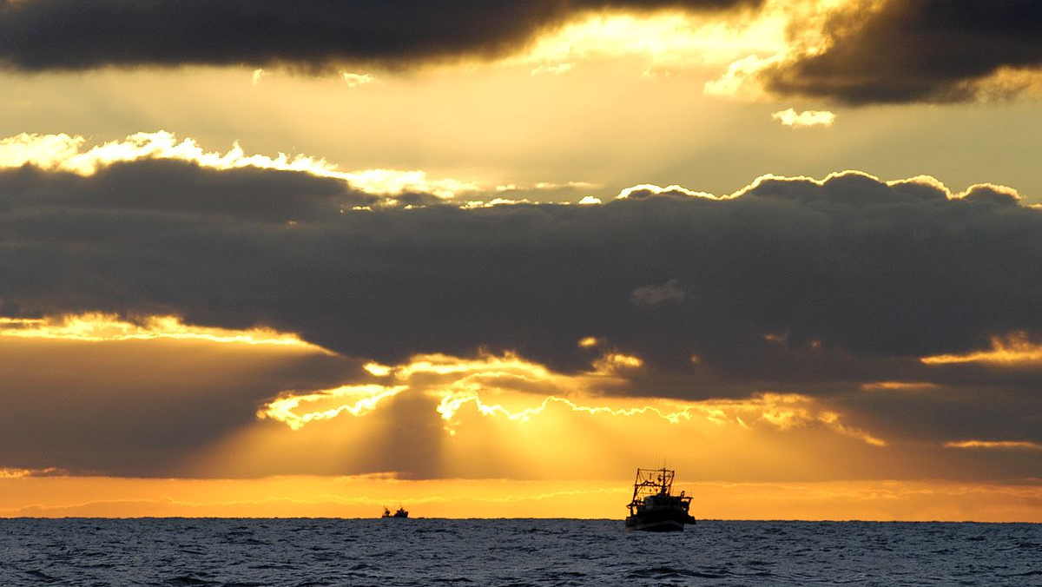
10 AOB & Summary of actions agreed and decisions adopted by the Chair
North Western Waters Advisory Council

Slide 27
Small Scale Fisheries
North Western Waters Advisory Council

